Slide 1
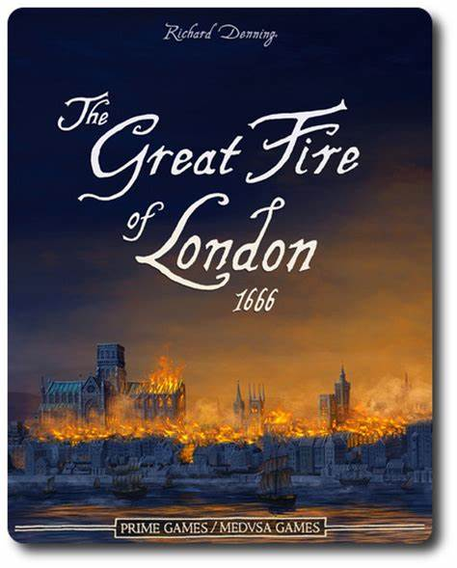
Theme: week beginning 9.11.20

Slide 2
Theme: week beginning 9.11.20
How do we know what happened in the Great Fire?
What is an eyewitness?
How can an eyewitness help us to know what happened in the past?

Slide 3
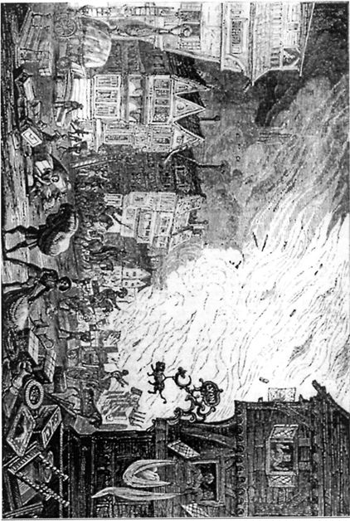
What does this eyewitness see?
Panicking citizens seek to save their possessions as the flames sweep towards them,
2–6 September 1666 [picture by unnamed artist in The Mirror, 5 October 1840]

Slide 4
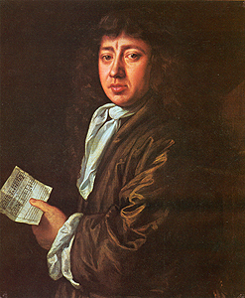
Samuel Pepys
We know about the Great Fire through the diary of a man called Samuel Pepys.
What is a diary?
Is a diary fact or fiction? What sort of information do people keep in diaries.
Why might diaries from the past be useful to us today?

Slide 5
Samuel Pepys' Diary
2nd September 1666
So I made myself ready presently, and walked to the Tower…and there I did see the houses at the end of the bridge all on fire.
So down [I went], with my heart full of trouble, to the Lieutenant of the Tower, who tells me that it began this morning in the King's baker's house in Pudding Lane, and that it hath burned St. Magnus's Church and most part of Fish Street already. So I rode down to the waterside…

Slide 6
Everybody is trying to move their goods or fling them into the river or bring them onto boats. Poor people stay in their houses until the fire touches them. Then they run into the boats.
I saw the fire rage every way, and nobody trying to quench it, but instead trying to save their goods. The wind mighty high.
What do the diary's extracts tell us about the Great Fire?

Slide 7
Use the Fire of London game at: http://fireoflondon.org.uk/game and follow the character of Tom Porter as he tries to help stop the fire and rescue objects that have been burnt in the fire.
Can you write a diary entry of Tom Porter, describing what happened to him during the Great Fire? Start from Sunday morning on 2nd September 1666 and finish on Thursday 6th September 1666.
Complete worksheet Dear Diary…

Slide 8
Theme week beginning 9.11.20
Can I write a diary extract?
Use the Fire of London game at: http://fireoflondon.org.uk/game and follow the character of Tom Porter as he tries to help stop the fire and rescue objects that have been burnt in the fire.
Can you write a diary entry of Tom Porter, describing what happened to him during the Great Fire? Start from Sunday morning on 2nd September 1666 and finish on Thursday 6th September 1666.
Dear Diary
________________________________________________________________________________________________________________________________________________________________________________________________________________________

