Slide 2
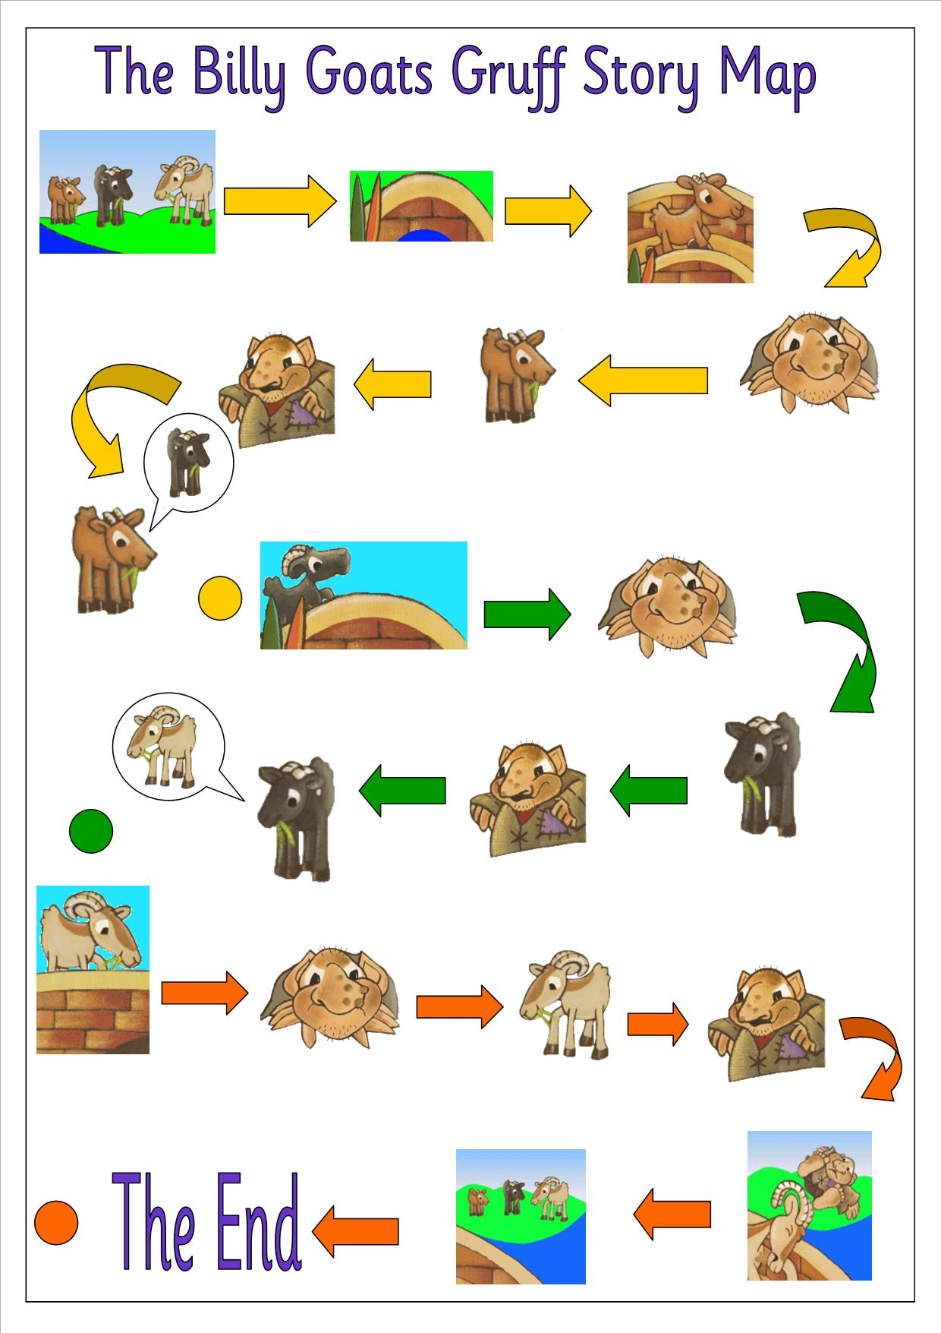
Lesson 1
Retell a traditional tale to an adult use the story map to help you and remember to use actions .

Slide 3
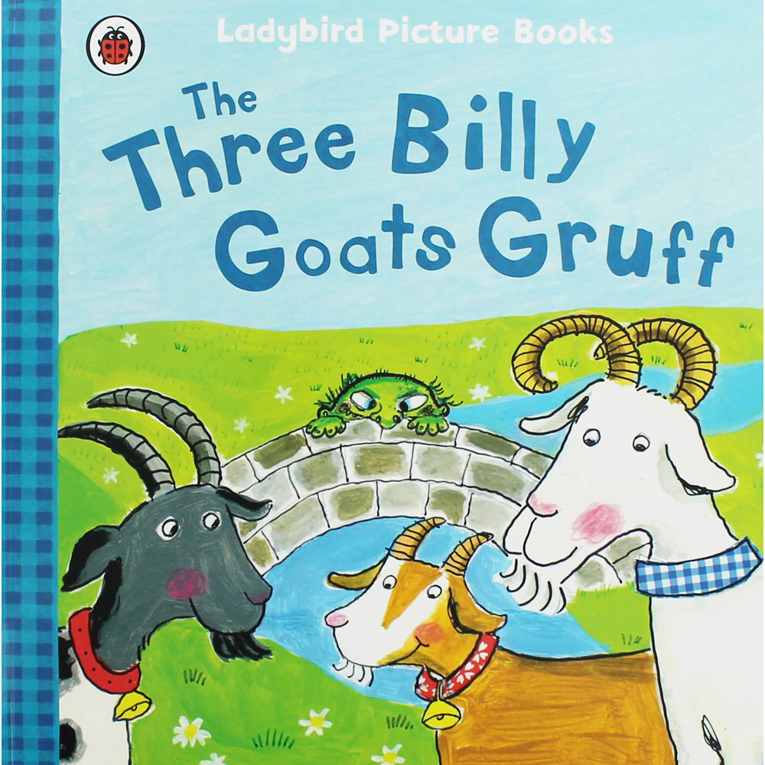
This week we are going to continue to look at the story of the Three Billy Goats Gruff. If you forgotten the story
Watch it first
https://www.youtube.com/watch?v=f4kdZTnizG4

Slide 4
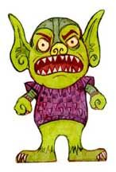
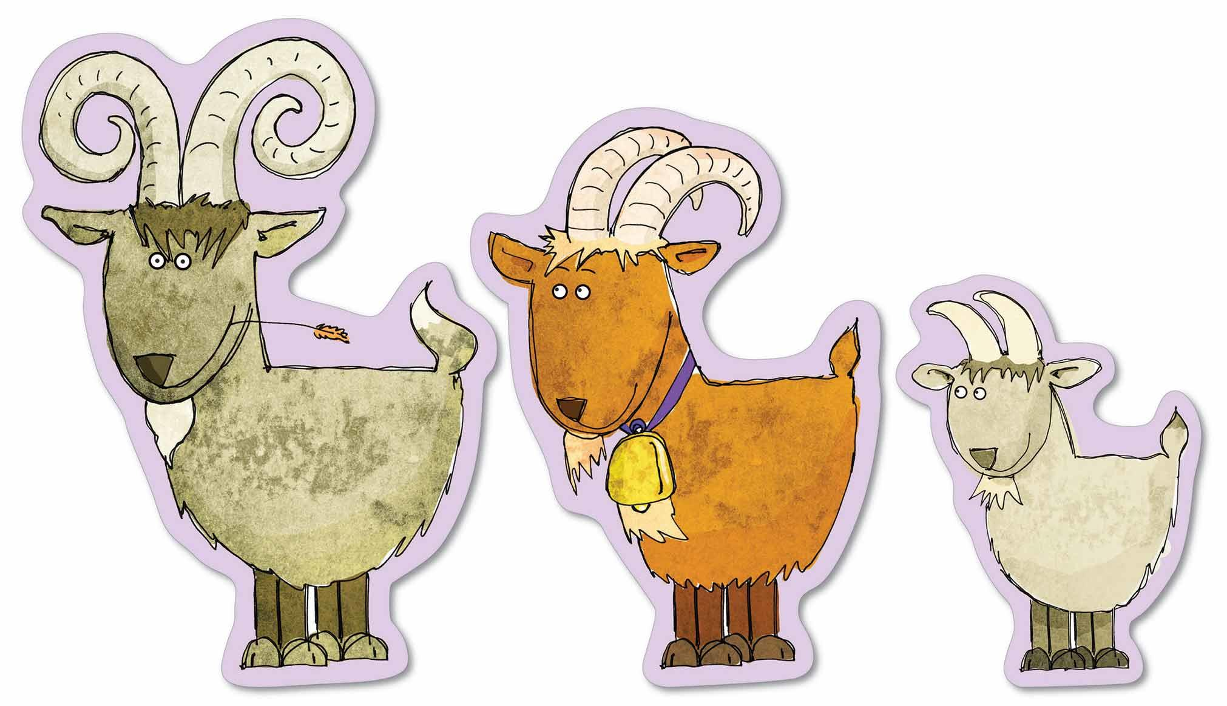
Lesson 1
We are starting by looking at the characters.
Which adjectives could describe each character?

Slide 5
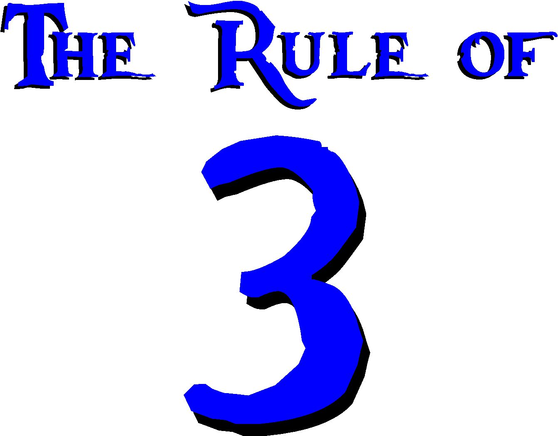
Lesson 1
Now using the adjectives you have thought of write a character description of the Troll and the
Three Billy Goats Gruff. Remember to use the rule of 3 for some of your sentences.
eg The nasty, vile and grumpy troll jumped up from
underneath the bridge
See lesson 1 resources for your sheet A and B

Slide 6
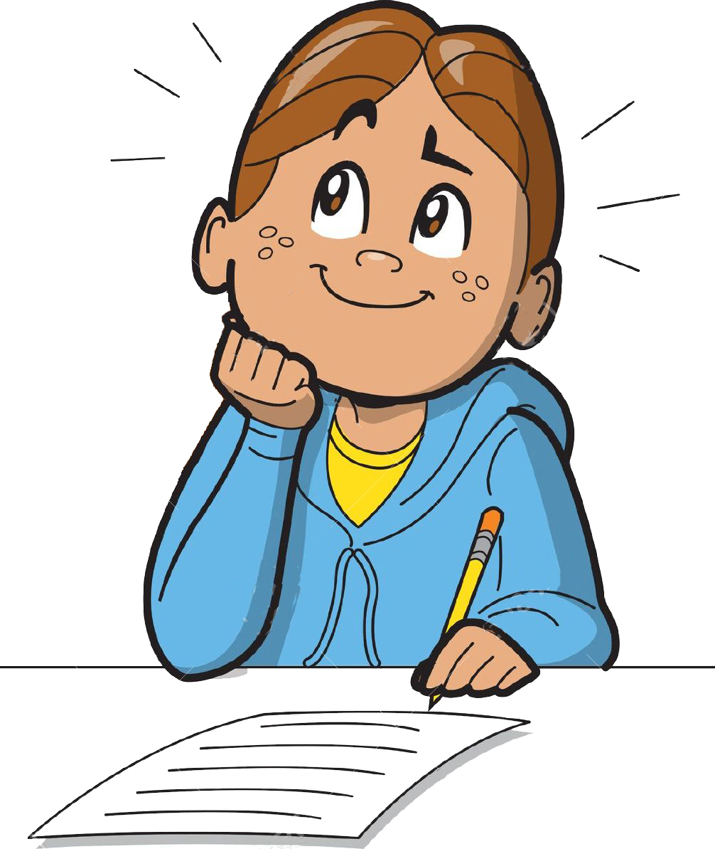
Lesson 2 Can I use different sentence starts?
Using different types of words to start a sentence makes our writing more interesting…. Here are some examples we are going to use..
Quickly (adverbs)
Early in the morning (connective openers)
On the other side of the bridge (preposition)
As quick as a flash (simile)
Sad, the troll (one word)
Trotting across the bridge (-ing word)
Exhausted the troll ( -ed word)
Fresh green grass ( adjective )

Slide 7
Can I use different types of words to start a sentence?
We ae going to use the story of the Three Billy Goats Gruff to write some amazing sentences using the different sentence starts. Don’t forget capital letter and full stops
Have a practise first saying the sentence before you write it down.
Can you think of a sentence using this adverb
as a sentence start?
Quickly _____________________________________

Slide 8
An example could be …
Quickly the little billy goat Gruff trotted off happily into the lush green meadow.

Slide 9
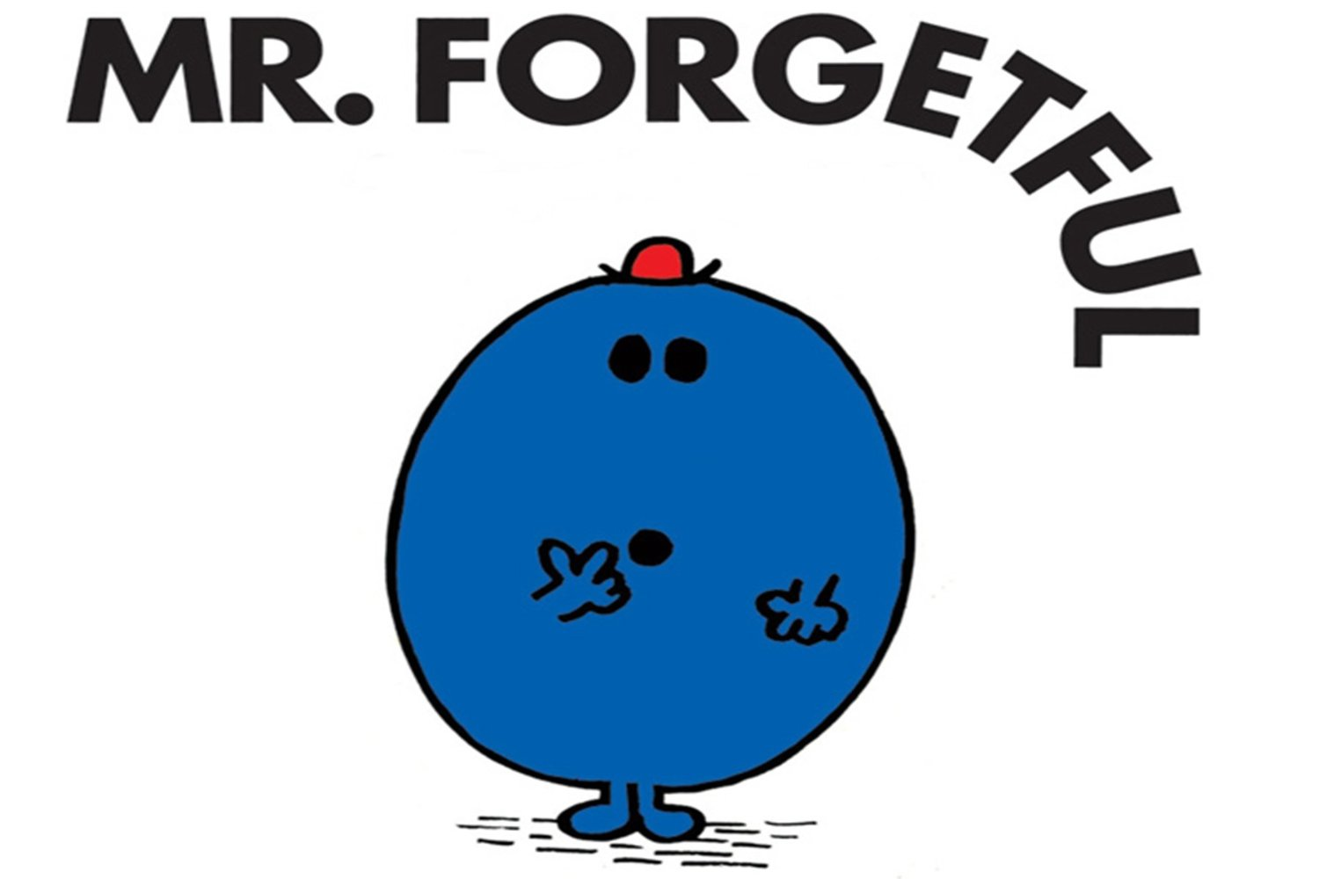
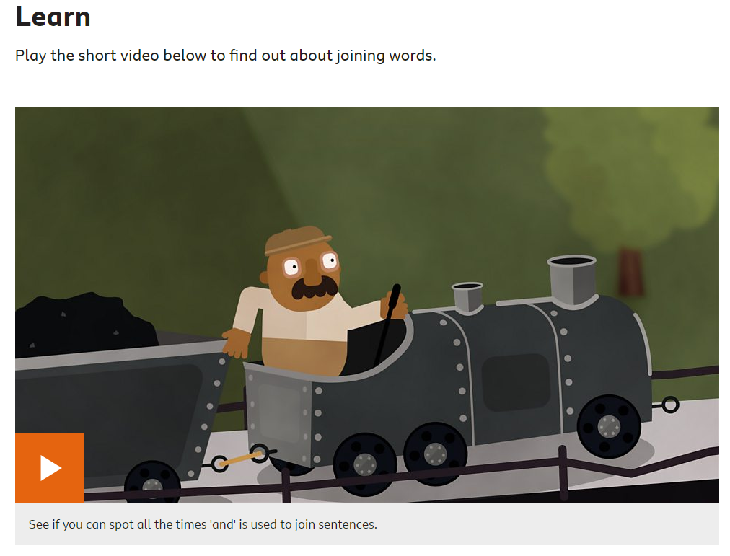
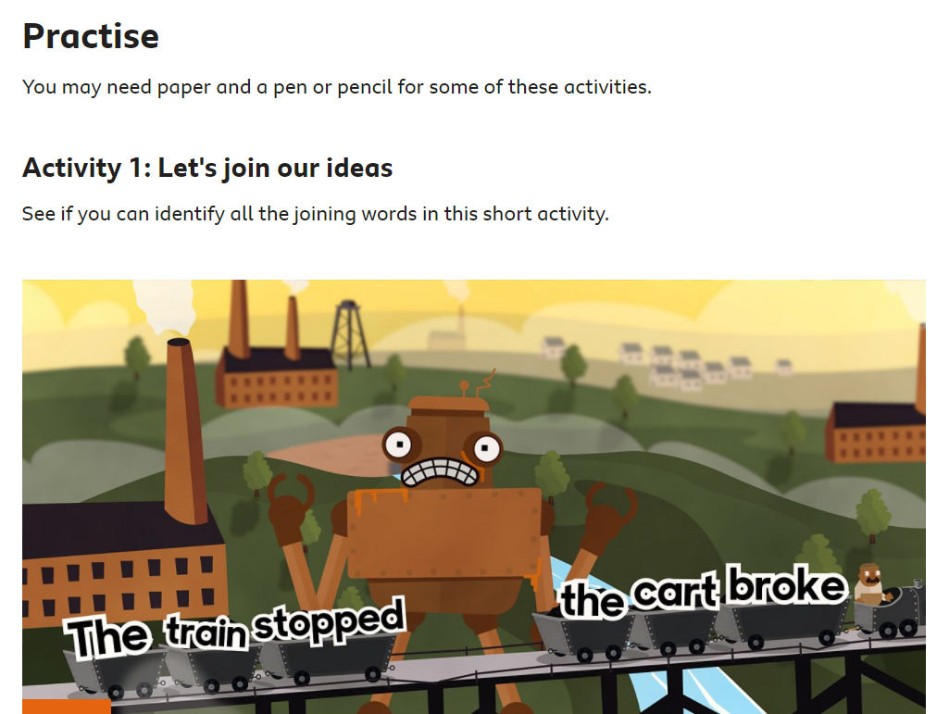
Lesson 3
Can I use conjunctions to join sentences?
If you’ve forgotten
about conjunctions
look at
https://www.bbc.co.uk/bitesize/articles/z6rvbdm

Slide 10
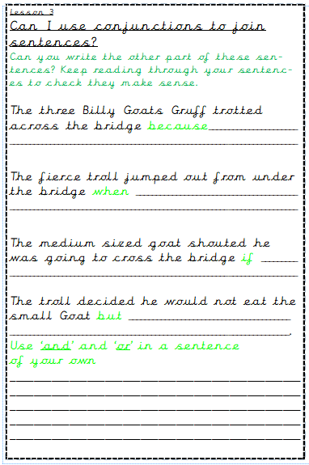
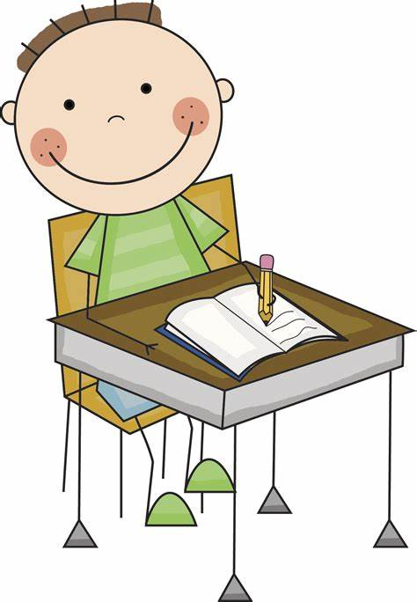
Now complete lesson 3
worksheet

Slide 11
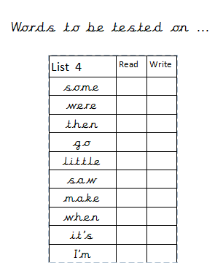
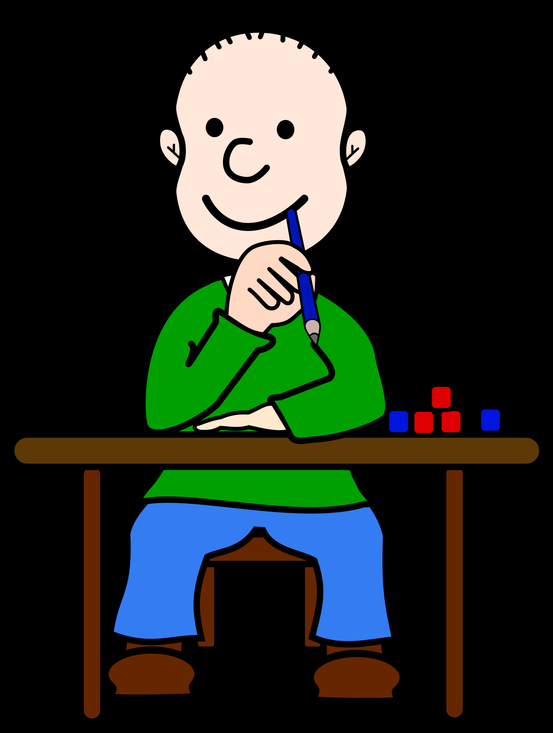
Lesson 4 Spelling high frequency words

Slide 12
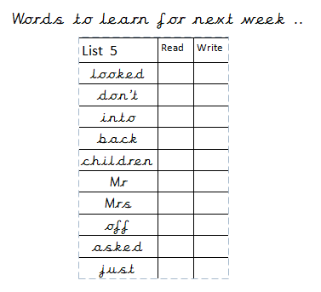
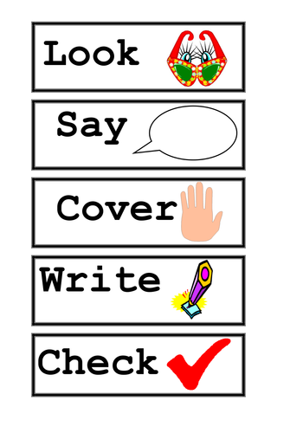
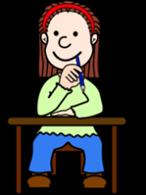

Slide 13
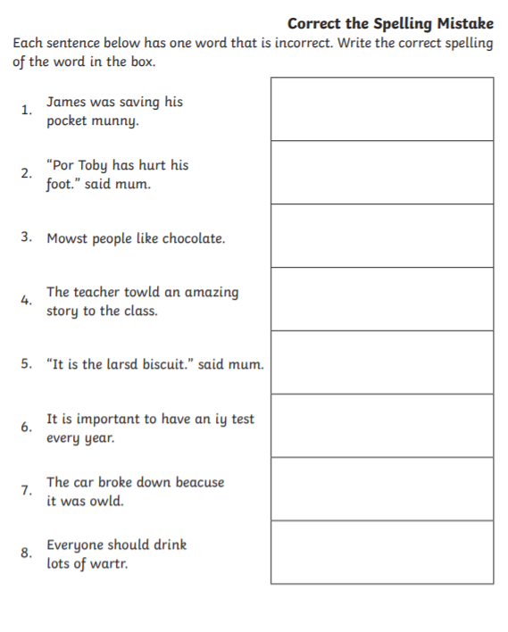
Lesson 4

