Slide 1
Express yourself
By the home learning crew

Slide 2
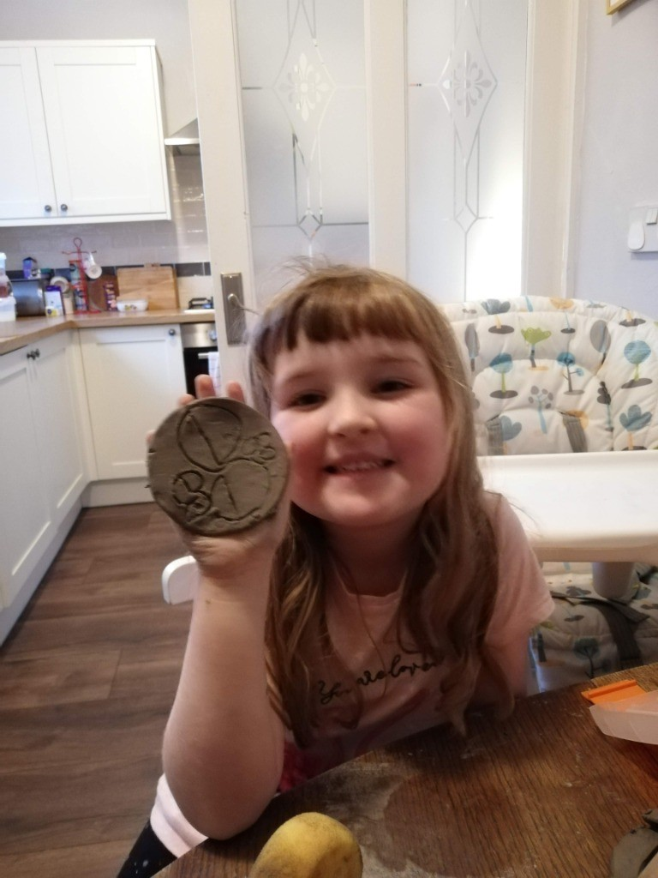
Saoirse expressing herself making a coaster!

Slide 3
Lydia singing on stage

Slide 4
Superstar cheerleader Lucy!

Slide 5
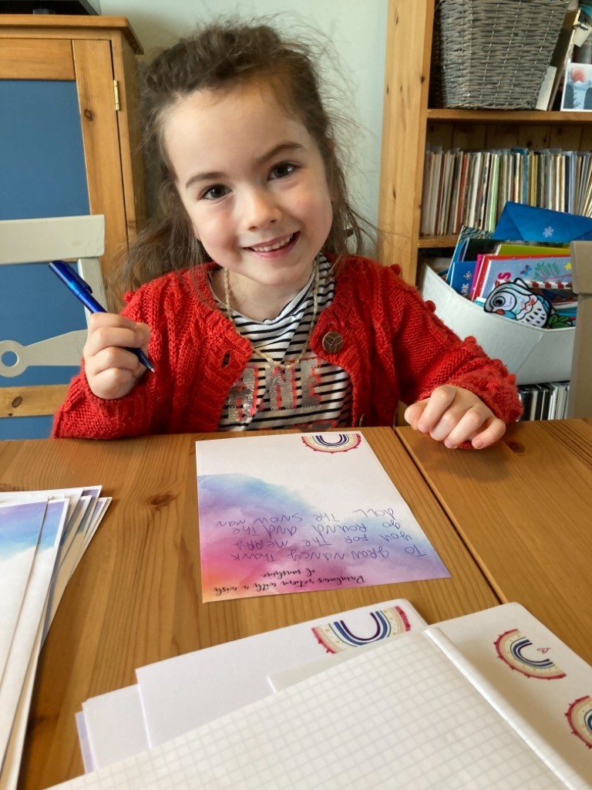
Eleanor expressing herself by writing letters.

Slide 6
Little rock star Mya

Slide 7
Poppy and her pretty painting

Slide 8
Jasmine enjoying fresh air and exercise.

Slide 9
Liam expressing himself through painting.

Slide 10
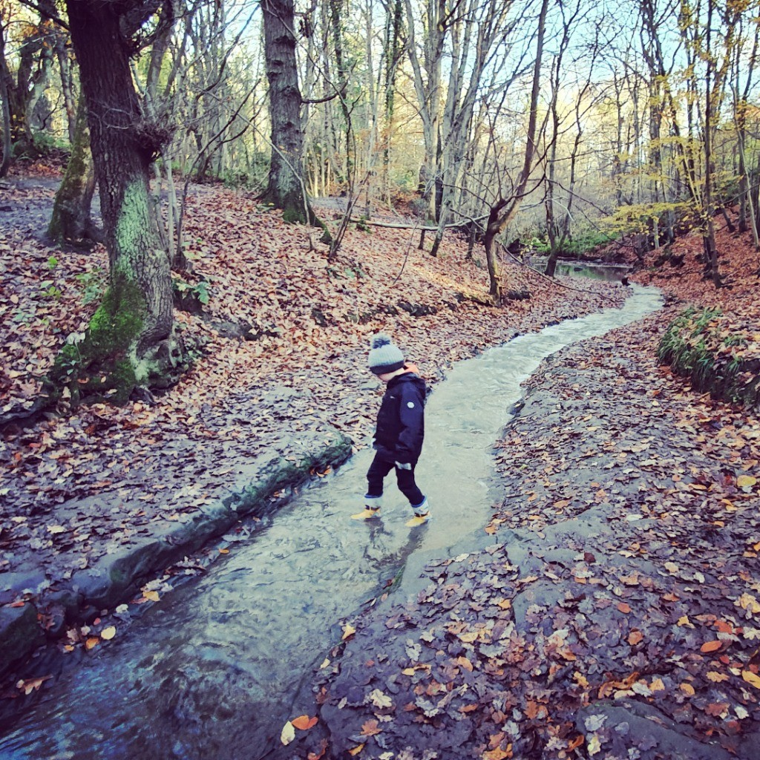
Flynn exploring the outdoors!

Slide 11
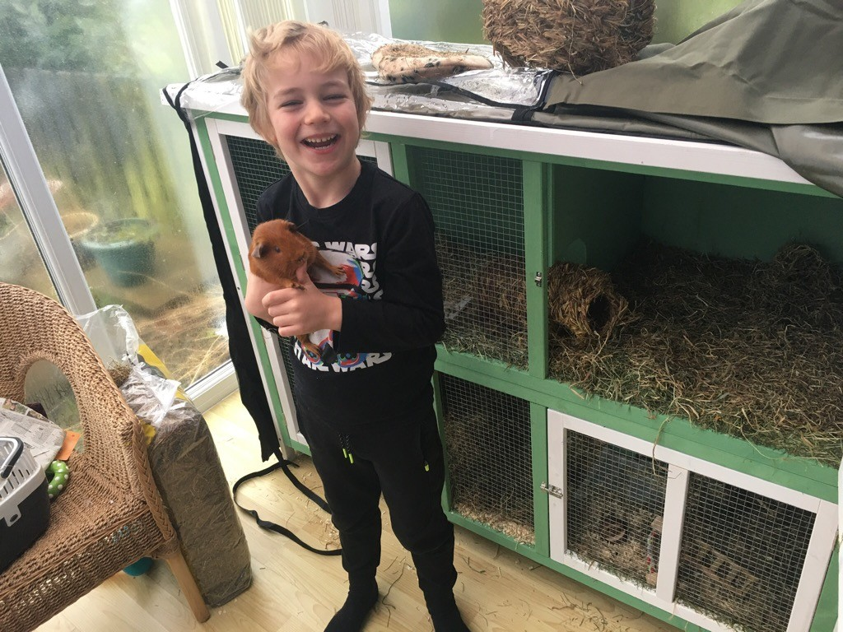
Charlie cuddling his guinea pig… it makes him feel happy and full of love!

Slide 12
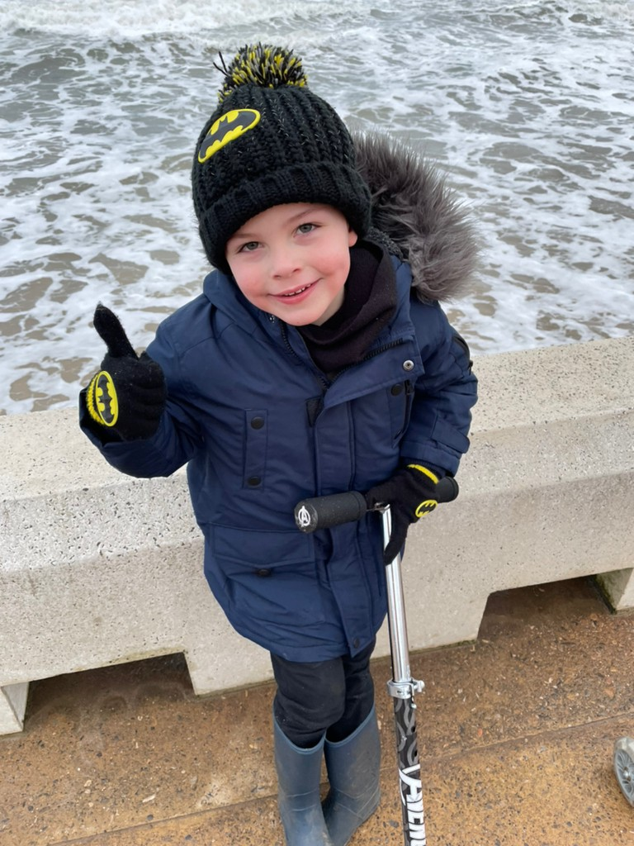
Jakob feeling happy to be outside enjoying the fresh air.

Slide 13
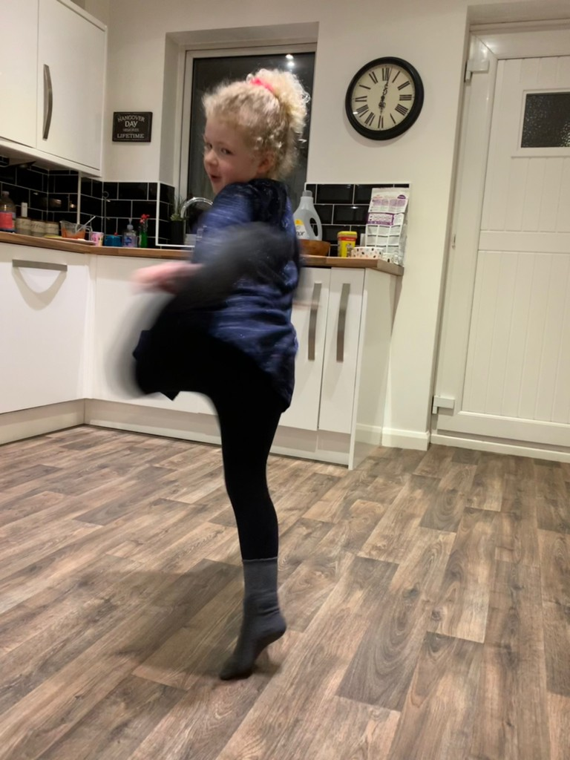
Katie enjoying a kitchen boogie!

Slide 14
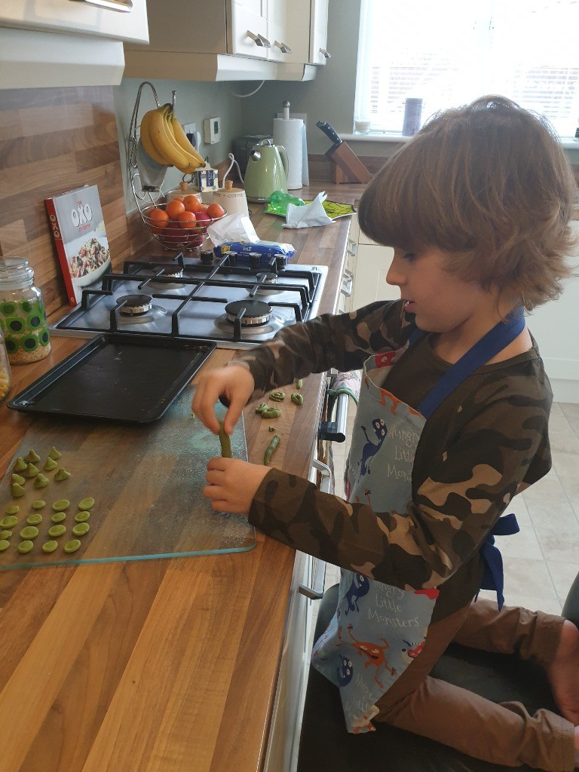
Seb expressing himself in the kitchen.

Slide 15
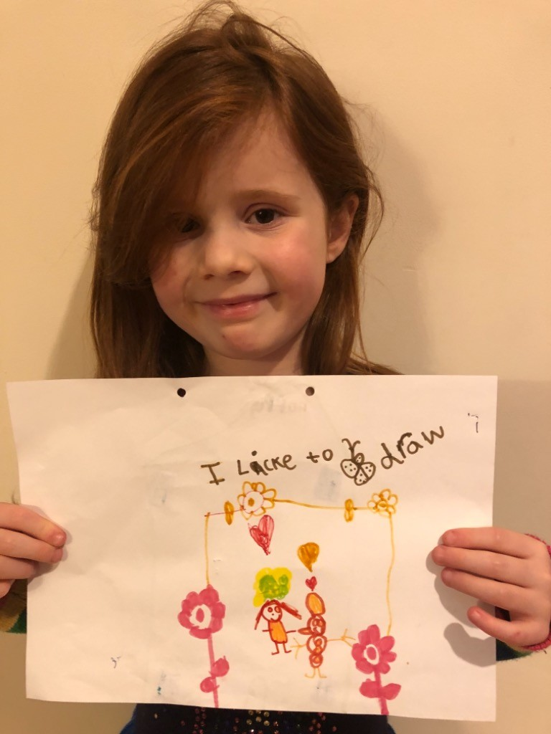
Poppy expressing herself through art.

Slide 16
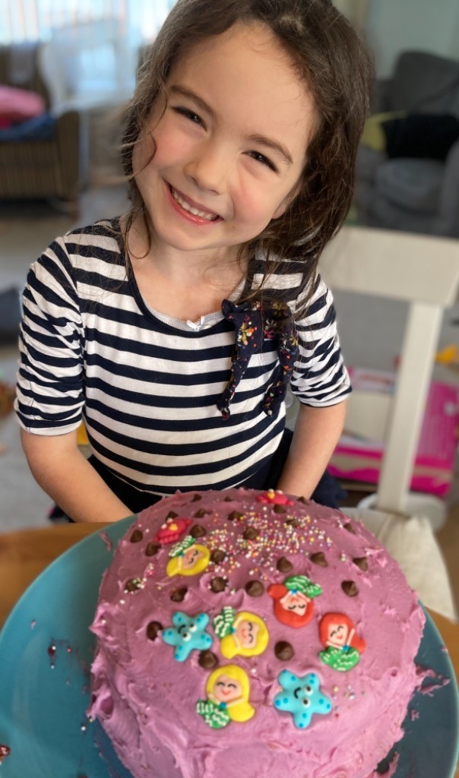
What a tasty looking cake Eleanor!

Slide 17
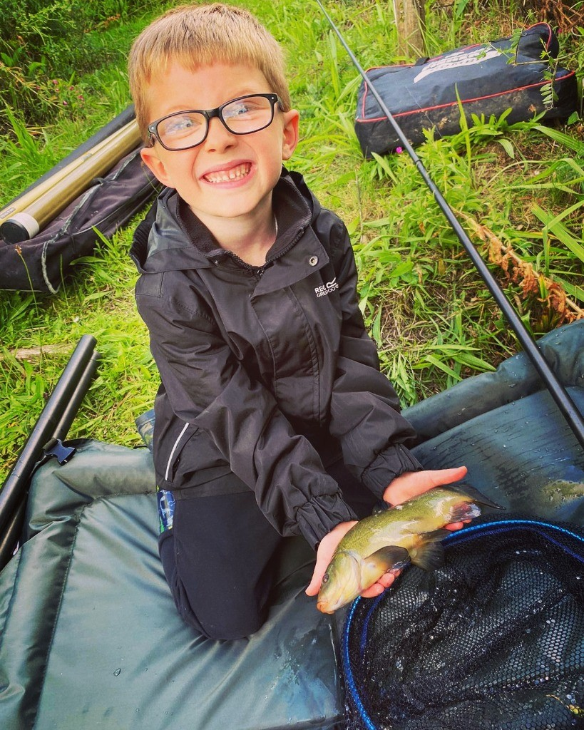
Flynn having a great time fishing!

Slide 18
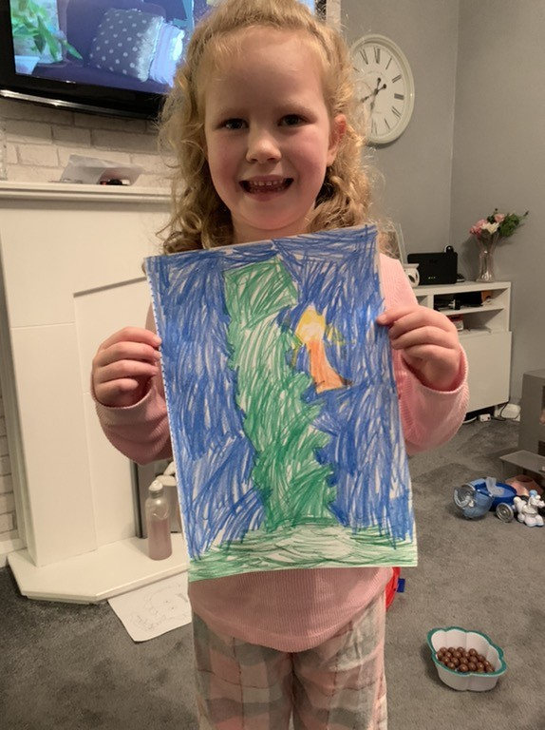
Lucy’s super art work!

Slide 19
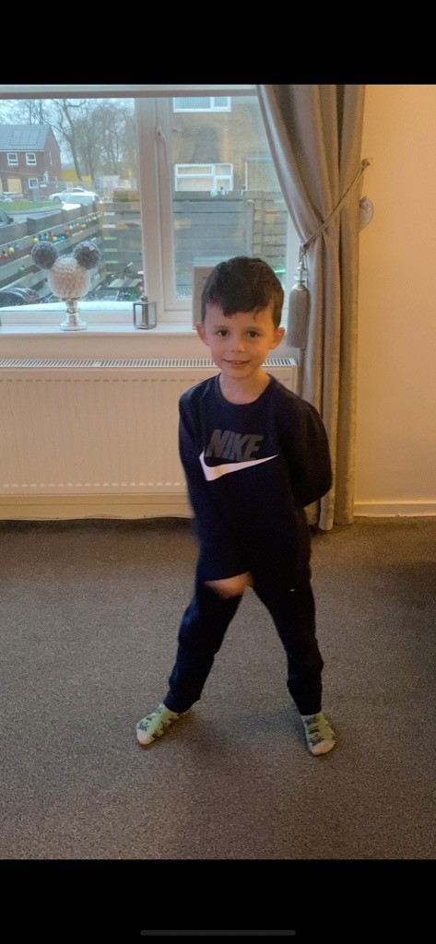
Superstar dancer Teddy!

Slide 20

We have loved seeing all the ways you express yourselves.
It is so important at the moment that we keep doing things that make us happy.

