Slide 1
Grendel A cautionary tale about chocolate
Day 2
Let’s read on…

Slide 2
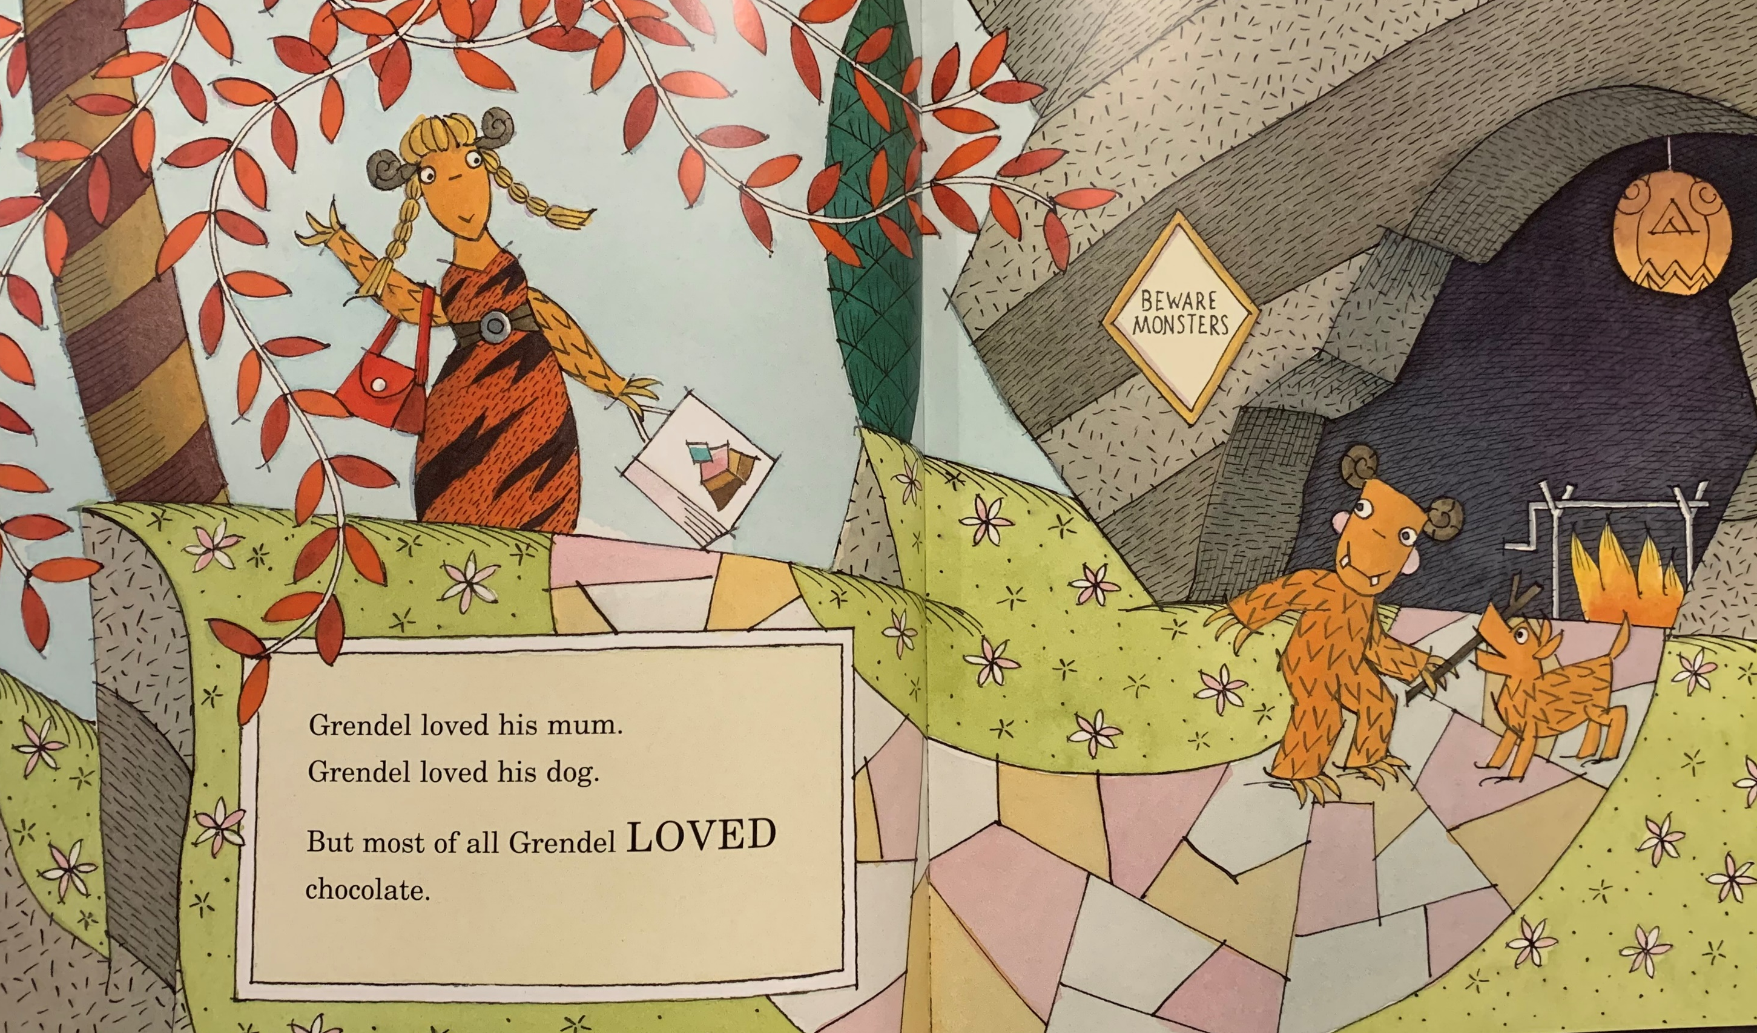

Slide 3
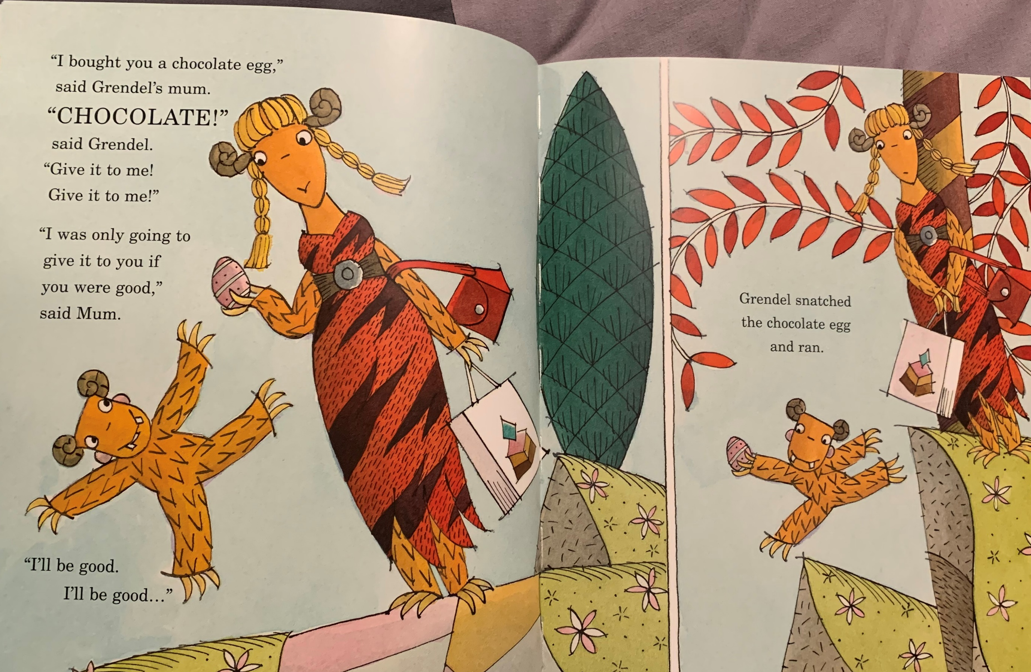

Slide 4
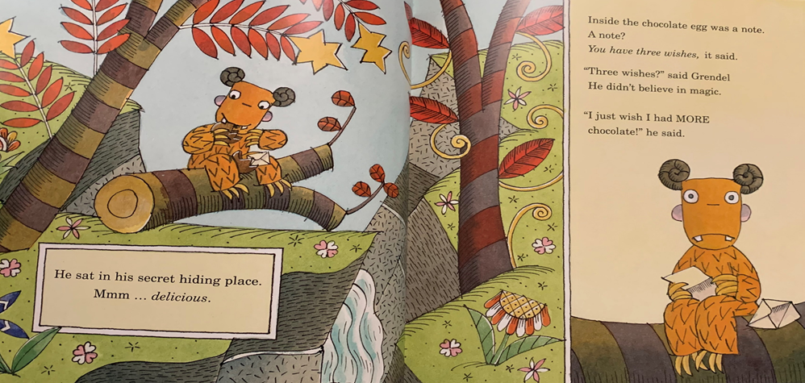
Task 4
What do you think of Grendel now?
________________________________________________________________________________
“snatched” “Give it to me!”
Do we know more about his character?
________________________________________________________________________________

Slide 5
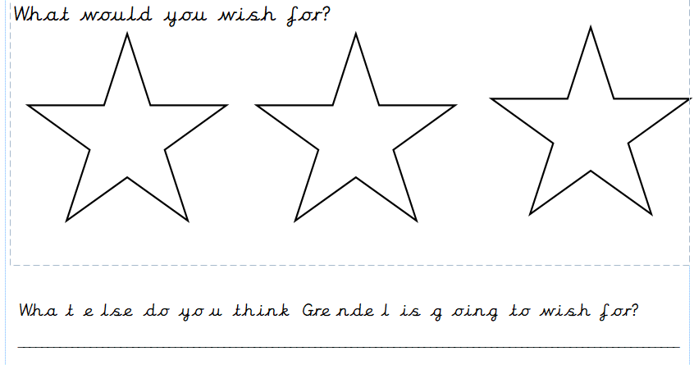
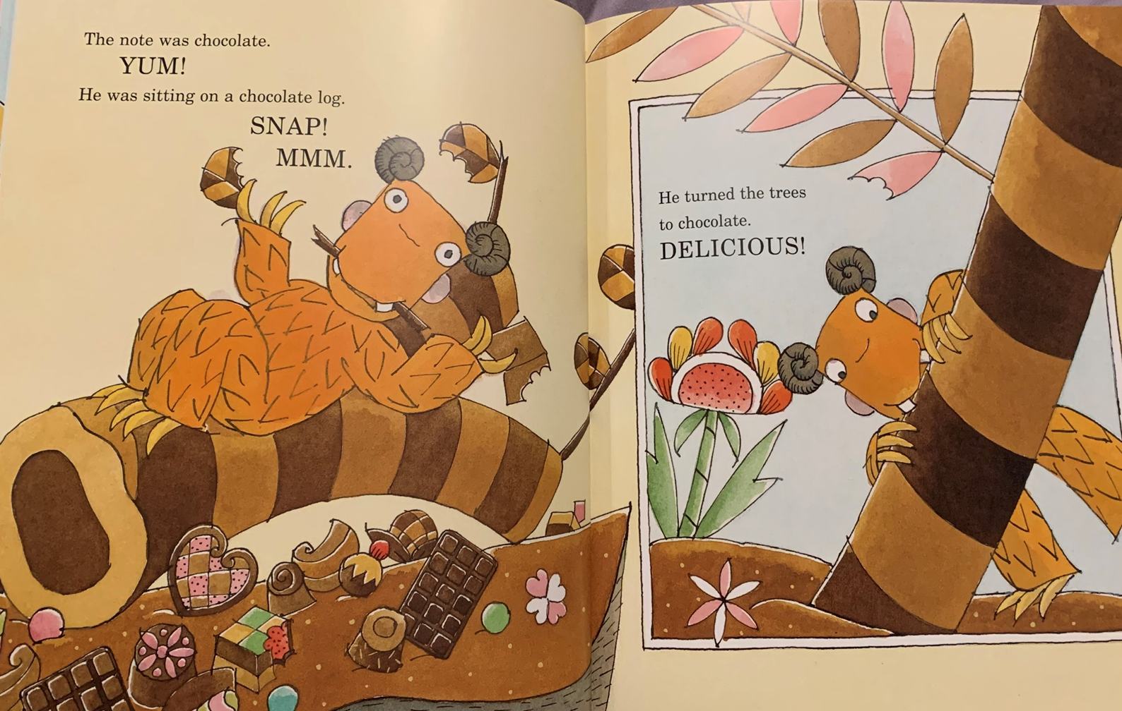
Task 5

Slide 6
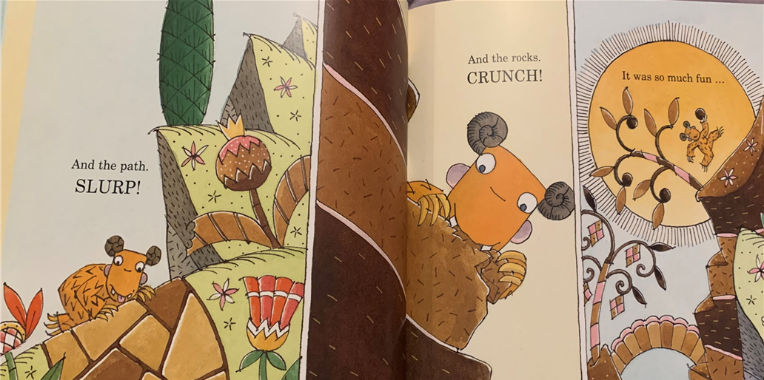
Task 6 What do you think about Grendel’s wish? ______________________________________________________________________________________________________________________________________________________________________________________________________________________________________________________________________________________________________________________________

Slide 7
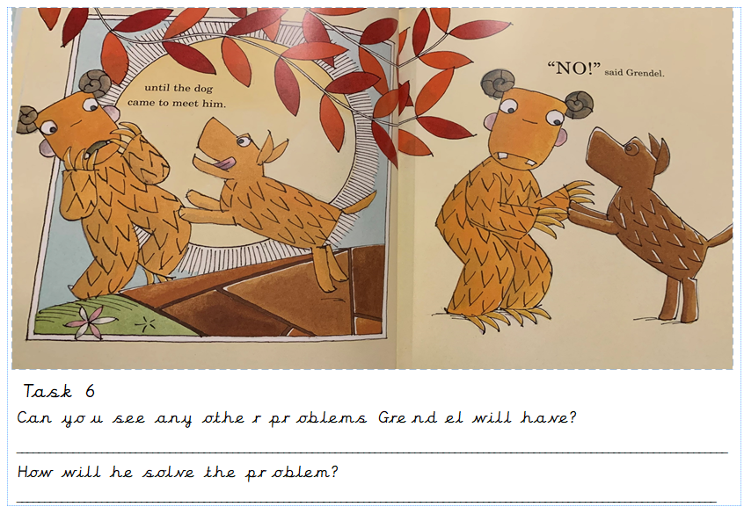

Slide 8
Read on and find out … How will the story end?
or

Slide 9
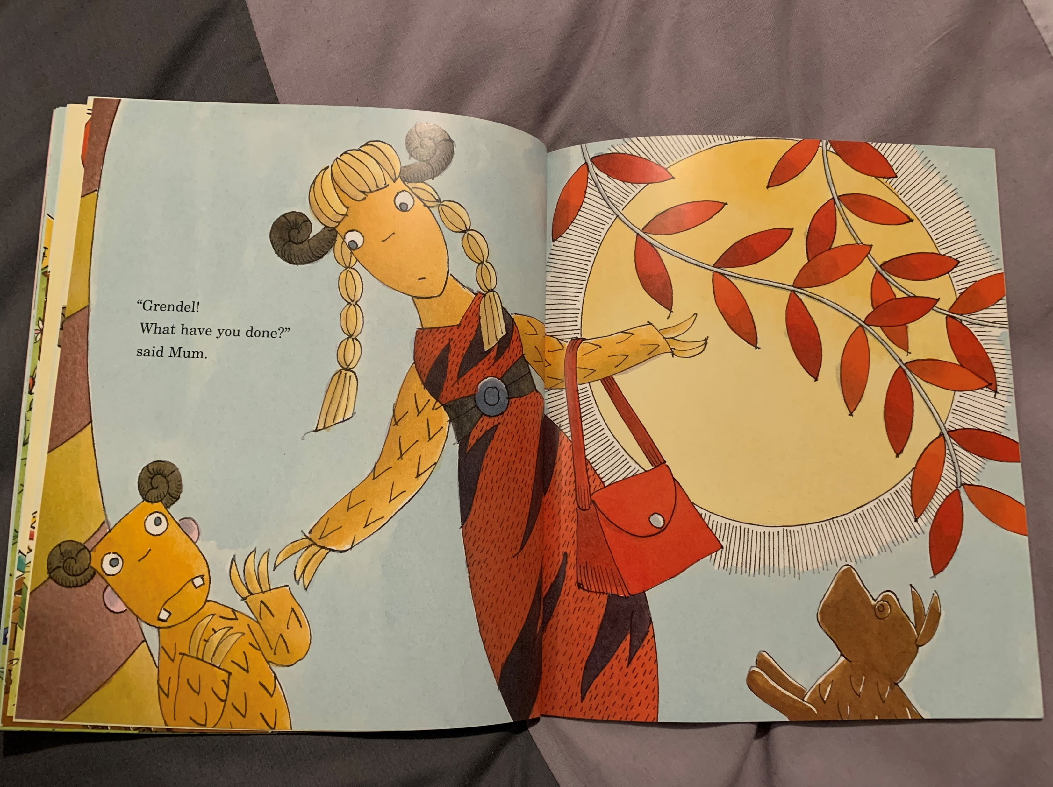

Slide 10
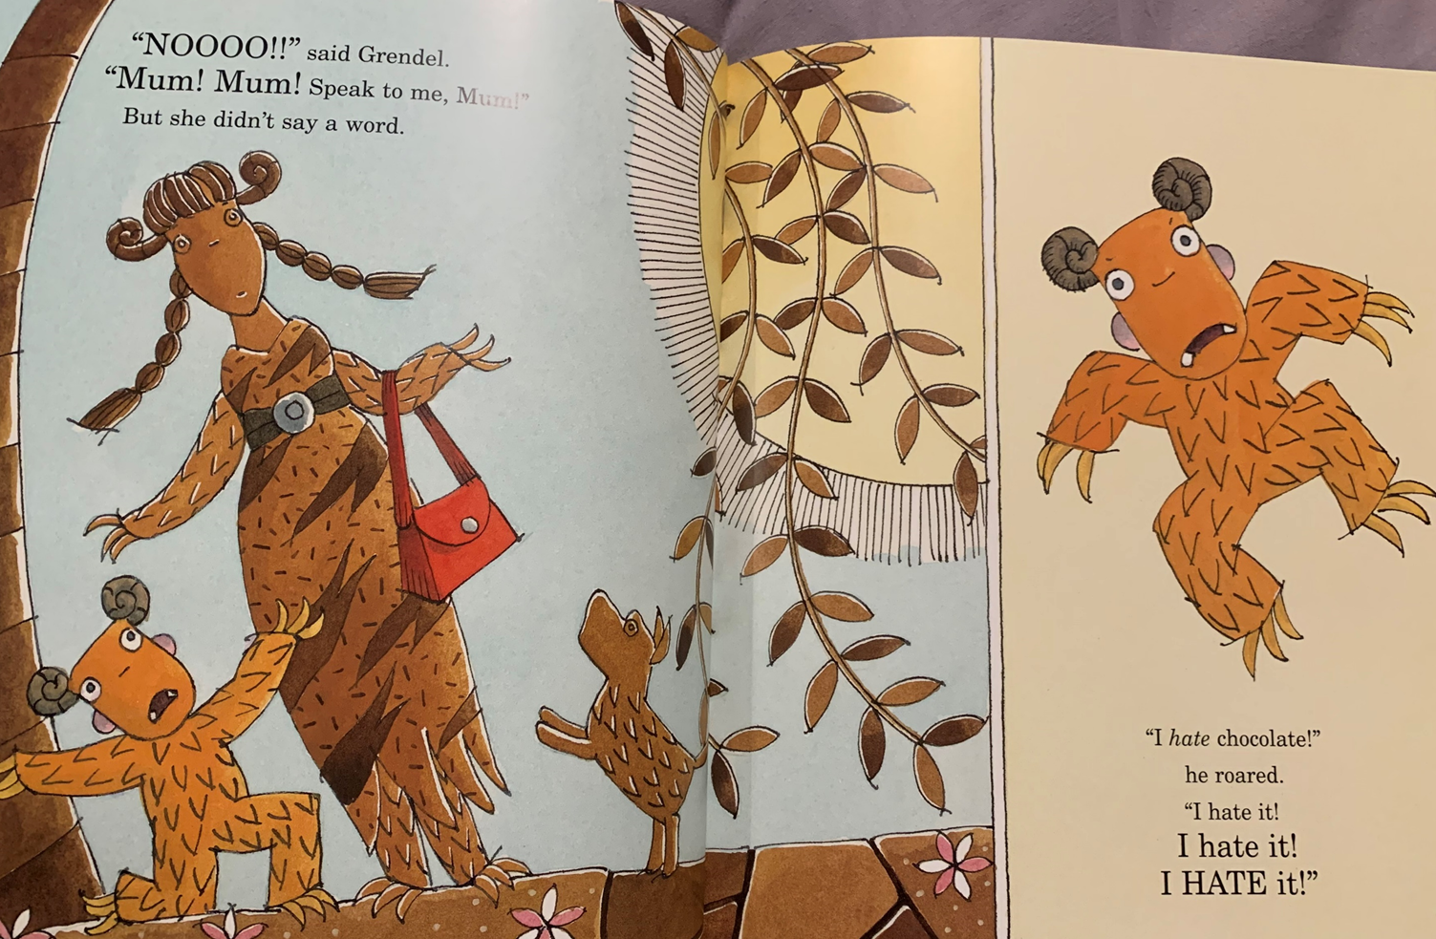

Slide 11
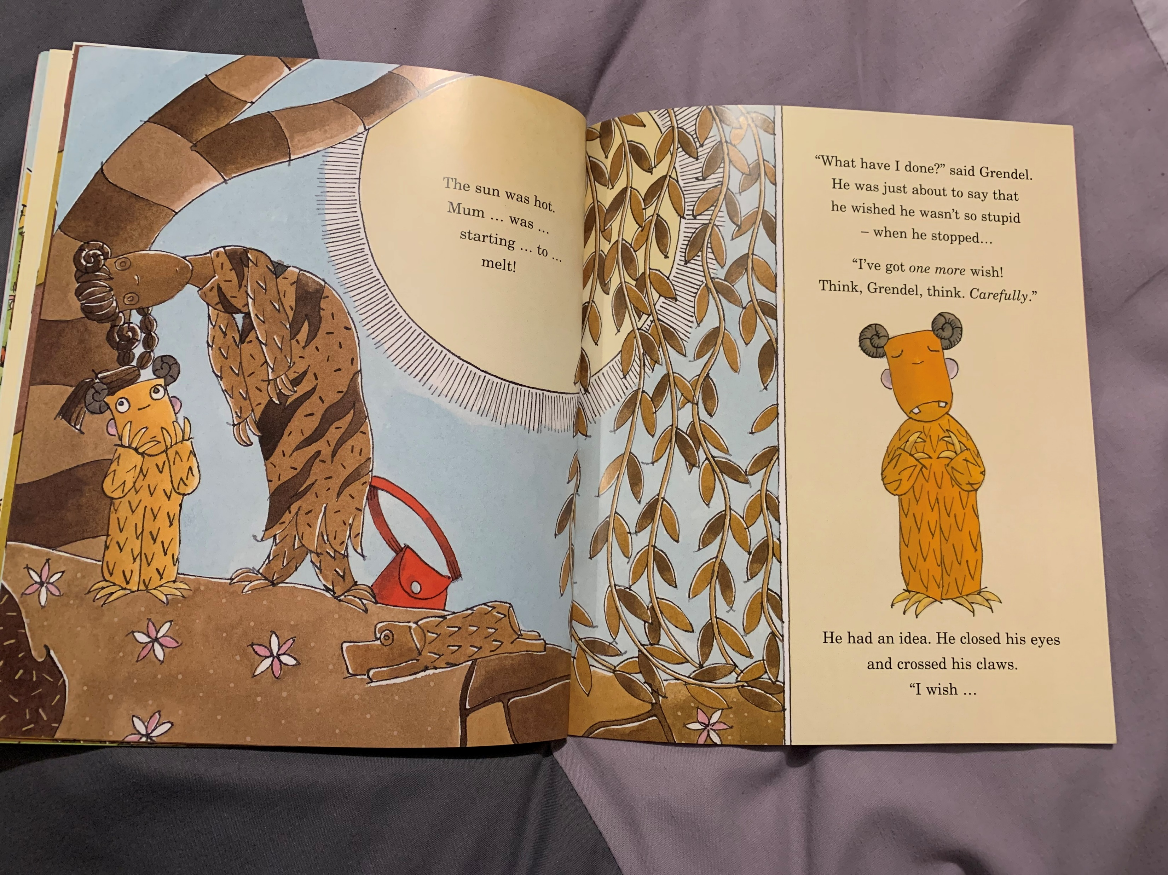

Slide 12
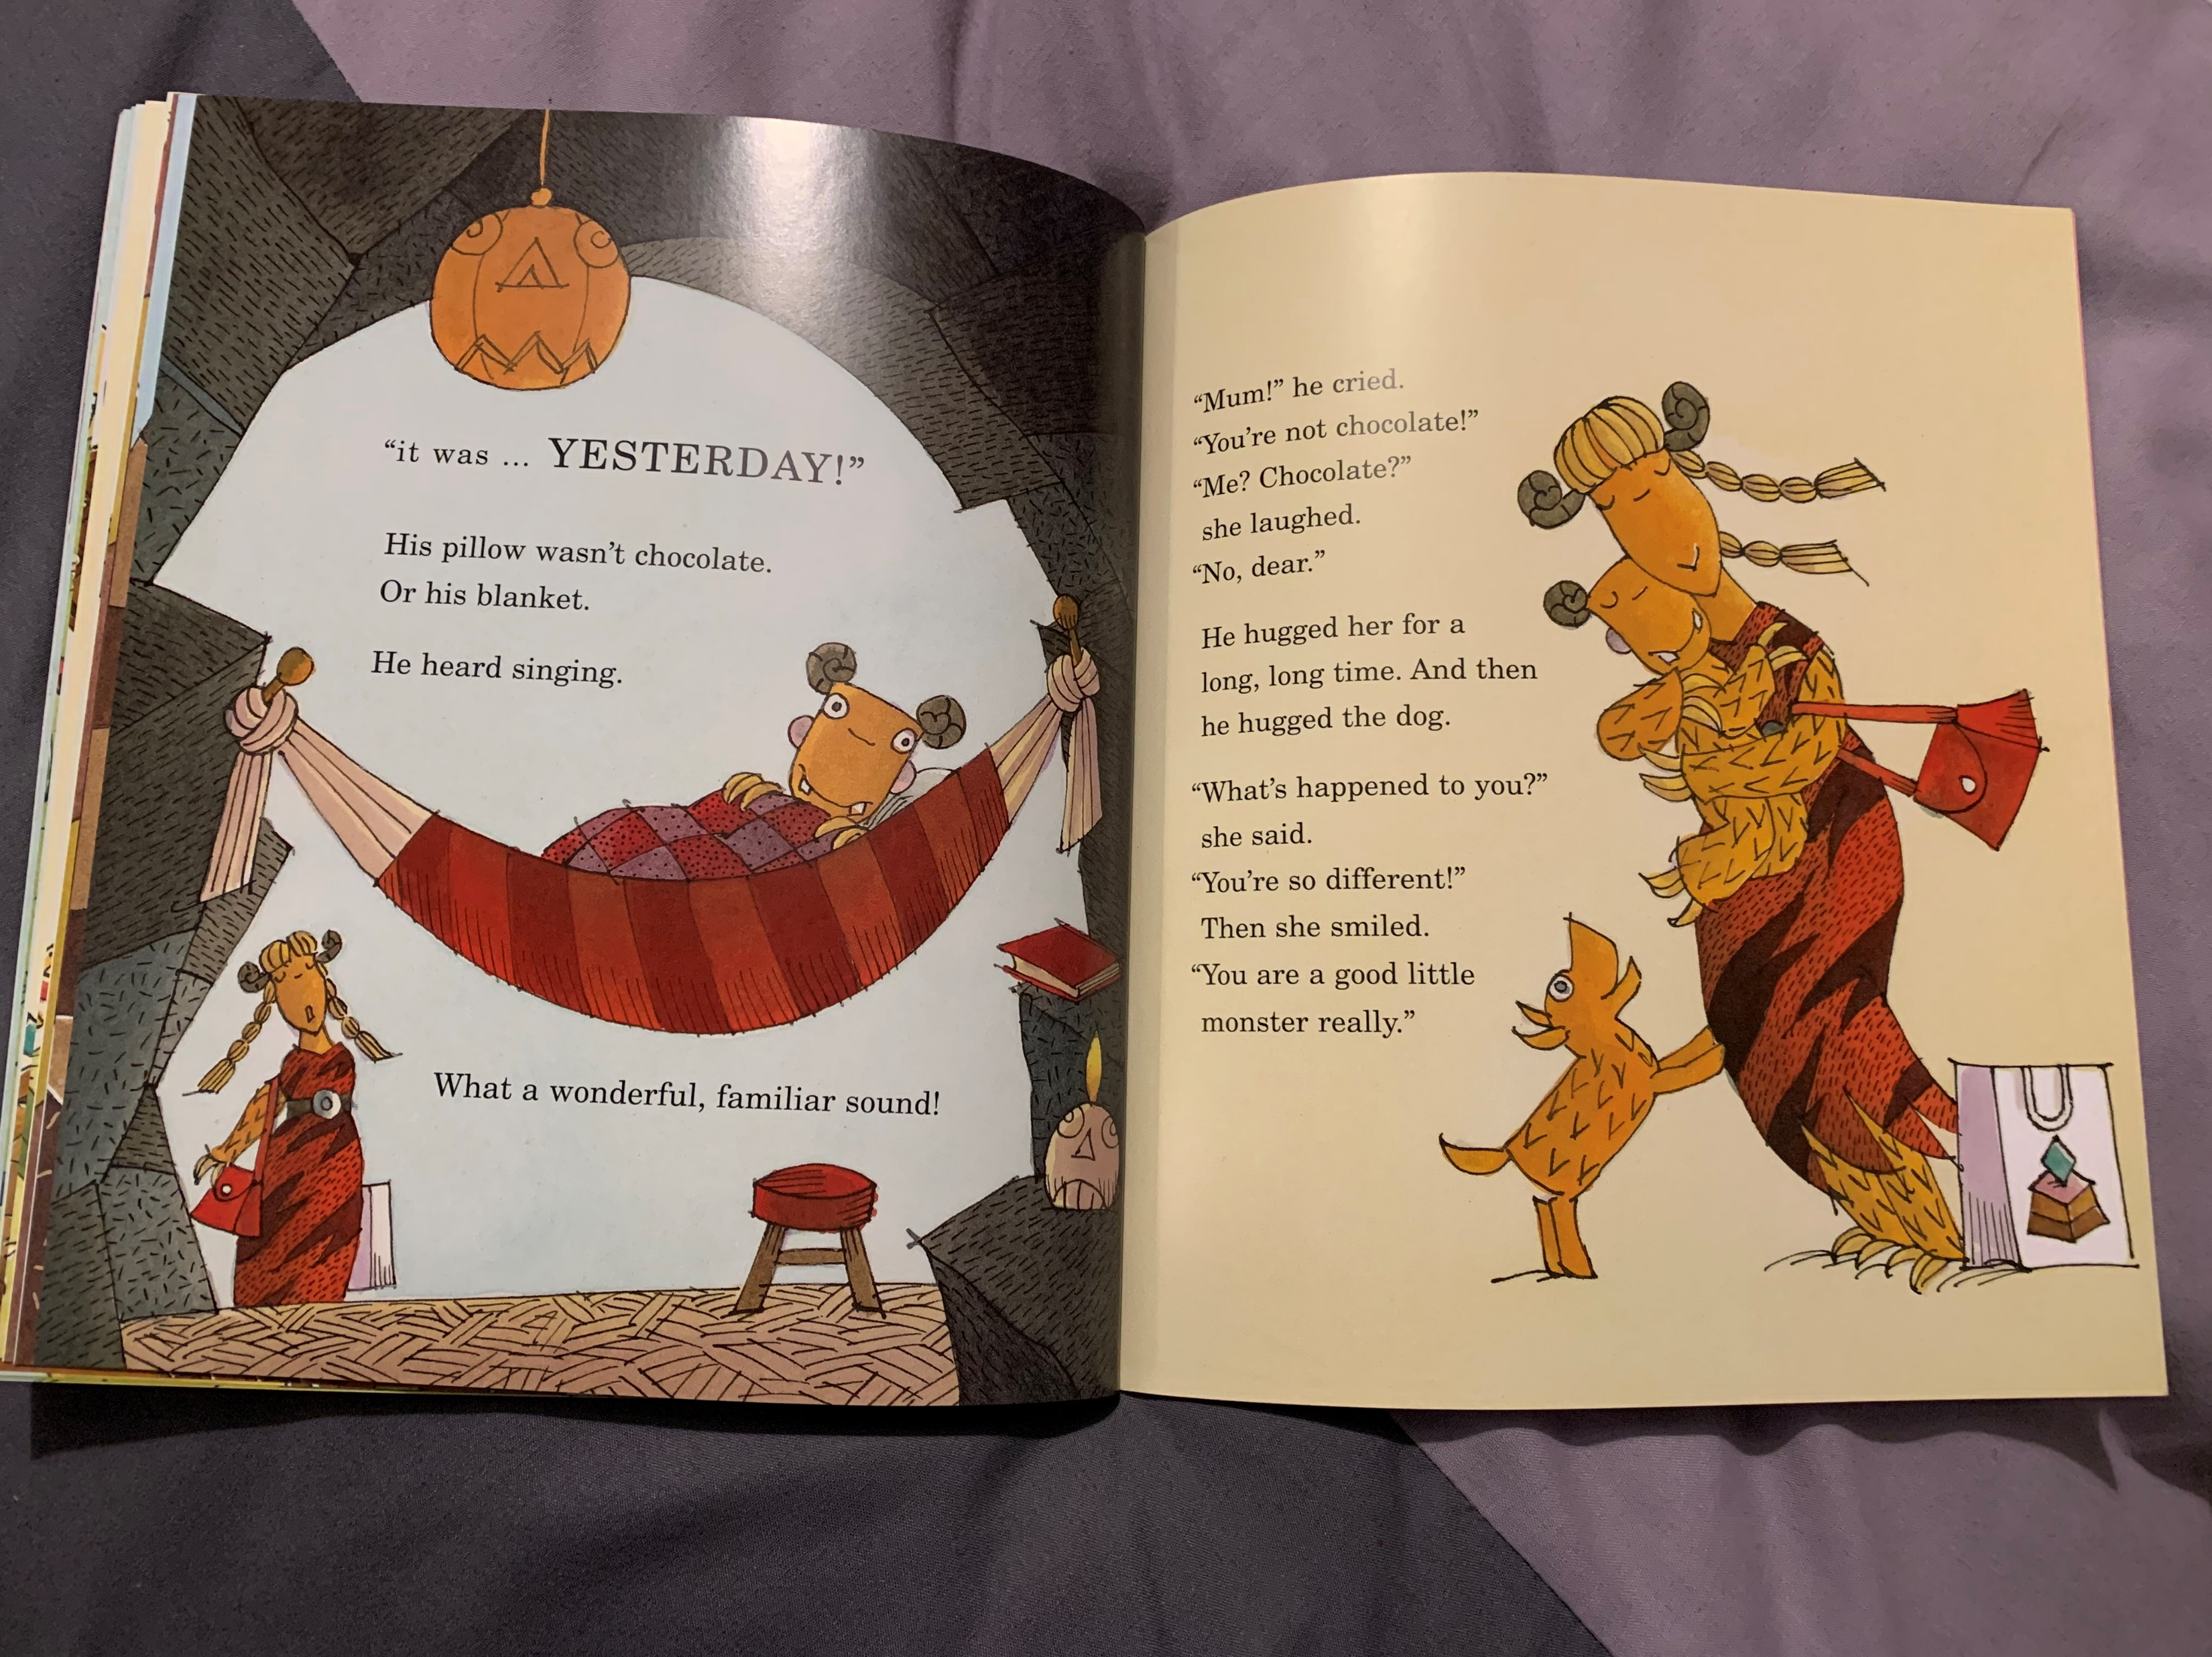

Slide 13
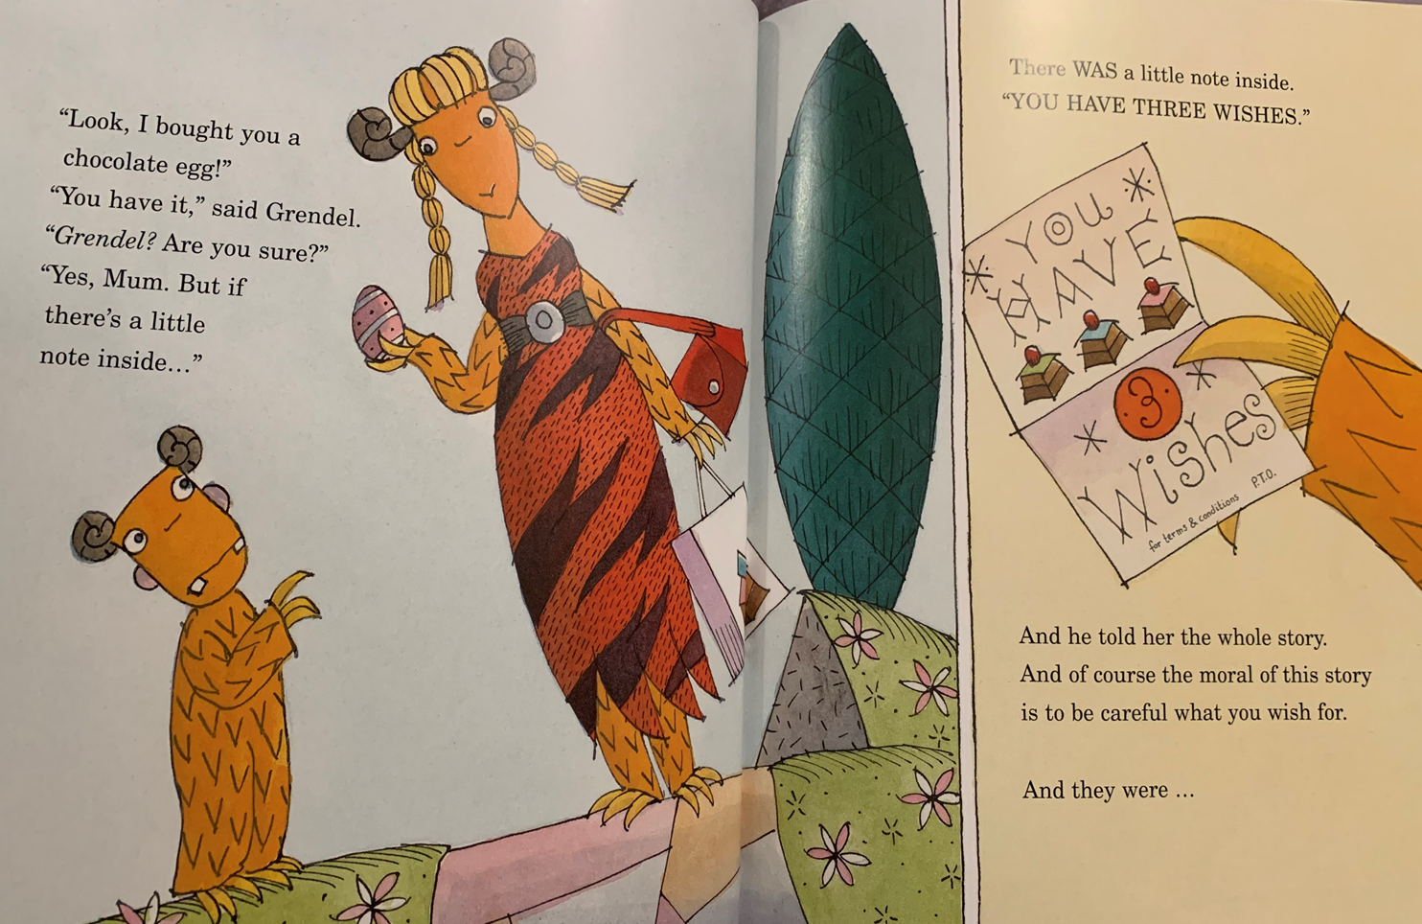

Slide 14
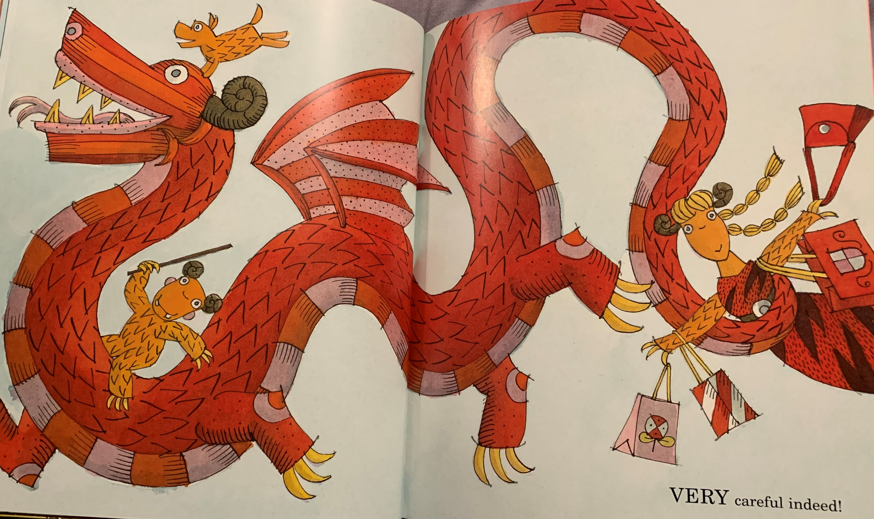

Slide 15
Things to think about …
Did you like the story?
Can you see why it is
a cautionary tale now?
Would you change your
3 wishes now?

