Slide 1
Gymnastics
@ Home
Active me: Can you explore different ways of rolling or rotating? Take a look at some different moves below, can you do any?
Develop me:
How many different rolls/ rotations can you do?
Do you travel from one spot to another during the move?
Could you make one roll or rotation really quick and one really slow?
Rolls & Rotations – Stage 1
Gail’s Tips – Egg Roll
Keep chin tucked in. Keep knees in tuck shape, start on your back or front, whichever works best for you.
Gail’s Tips – Teddy Bear Roll
Sit in a straddle position. Legs straight and toes pointed, hands just below knees and back rounded. Roll on your back only, shoulder to shoulder.
Recommendations:
Check with an adult before starting
Tie hair back & no jewellery
Make sure you have enough suitable space around you and that there are no hazards
Physical activities can have a risk of injury, please ensure you participate in activities suitable to your skill level. Taking part in the activities are at your own risk.
Challenge me:
Could you put 2 or 3 rolls together? Can you find different ways to move between each one?
@NorthTynesidePE

Slide 2
Gymnastics
@ Home
Active me: Can you perform a rotation or roll of your choice?
Take a look below, can you do any?
Develop me:
Explore the transfer of weight during your roll or rotation.
Does your weight move to different body parts during the move?
Rolls & Rotations - Stage 2
Gail’s Tips – Log Roll
Arms stretched up and squeeze your ears
Gail’s Tips – Cartwheel
Fingers together and lunge into your cartwheel. Think of a rainbow shape … 1st hand, 2nd hand, 1 foot & then 2nd foot down.
Challenge me:
Could you link a couple of rotations or rolls together? Could you find different ways to travel between each one?
Recommendations:
Check with an adult before starting
Tie hair back & no jewellery
Make sure you have enough suitable space around you and that there are no hazards
Physical activities can have a risk of injury, please ensure you participate in activities suitable to your skill level. Taking part in the activities are at your own risk.
@NorthTynesidePE

Slide 3
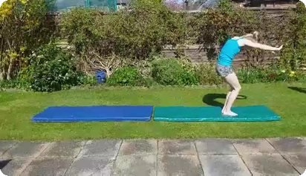
Gymnastics
@ Home
Active Me: Can you perform a roll or rotation of your choice? Take a look below, can you do any?
Develop me:
Explore your start and finish position.
Could you get a family member to capture the roll or rotation?
Is the move controlled?
Do you think you could make any improvements?
Rolls & Rotations - Stage 3
Gail’s Tips - Forward Roll
Chin on chest throughout. Push from feet. Tighter tucked knees into tummy makes it easier to stand up.
Gail’s Tips - Backward Roll
Chin on chest throughout, squat position, push through the heels and then push through hands and into the squat position. You could land on your knees, feet or front support.
Recommendations:
Check with an adult before starting
Tie hair back & no jewellery
Make sure you have enough suitable space around you and that there are no hazards
Physical activities can have a risk of injury, please ensure you participate in activities suitable to your skill level. Taking part in the activities are at your own risk.
Challenge me:
Could you perform a sequence which includes 3 rolls or rotations, ensuring you travel smoothly between each one?
@NorthTynesidePE

