Slide 1
Year 6 SATs
Information for parents and carers 2022

Slide 2
What are SATs?
SATs are tests taken by children at the end of Year 6. The test papers are set by the DfE and they are not marked by school.
There are tests in Reading, Grammar, Punctuation and Spelling (GPaS) and Maths.
The tests are done over 4 days in May.

Slide 3
When are the SATs?
Children will sit the following SATs papers:
Monday 9th May
Grammar, Punctuation and Spelling (Paper 1)
Grammar, Punctuation and Spelling (Paper 2)
Tuesday 10th May
Reading
Wednesday 11th May
Maths Paper 1 (Arithmetic)
Maths Paper 2 (Reasoning)
Thursday 12th May.
Maths Paper 3 (Reasoning)

Slide 4
What happens if my child is poorly and can’t attend school on the day of a test?
The tests have to be taken on the set days. This is when all Y6 children in Britain take the same test.
If your child is poorly, we ask DfE if they can sit the test when they are well enough. They usually always say yes!
However, it is important to make sure your child is at school for the tests as it is not as nice for your child to do the test by themselves.

Slide 5
How long are the tests? What happens?
The standard timings of tests are shown but some children are entitled to extra time for specific reasons set by DfE:
Grammar, Punctuation and Spelling (Paper 1) – 45 minutes; Grammar, Punctuation and Spelling (Paper 2) – 15 minutes; Reading – 60 minutes; Maths Paper 1 (Arithmetic) – 30 minutes; Maths Paper 2 (Reasoning) – 40 minutes; Maths Paper 3 (Reasoning) – 40 minutes
The tests will take place during normal school hours, under exam conditions.
Children are not allowed to talk to each other from the moment the test papers are handed out until they are collected.
Afterwards, the completed papers are sent away to be marked externally.
The children’s results are sent back to school at some point in July.

Slide 6
What do the results look like?
Once marked, the tests will be given the following scores:
A raw score (the total number of marks achieved for each paper)
A scaled score (which is explained below)
A judgement of whether the National Standard has been met.
After marking each test, the external markers will convert each raw score into a scaled score to show whether each child is working below, at or above the national standard.
When the scaled score is given, it is given in a range from 80 to 120.
A scaled score of 100 or more is meeting the national standard. There are no separate tests for higher achieving pupils; however, a scaled score close to 120 would show that a child is working above the national standard.

Slide 7
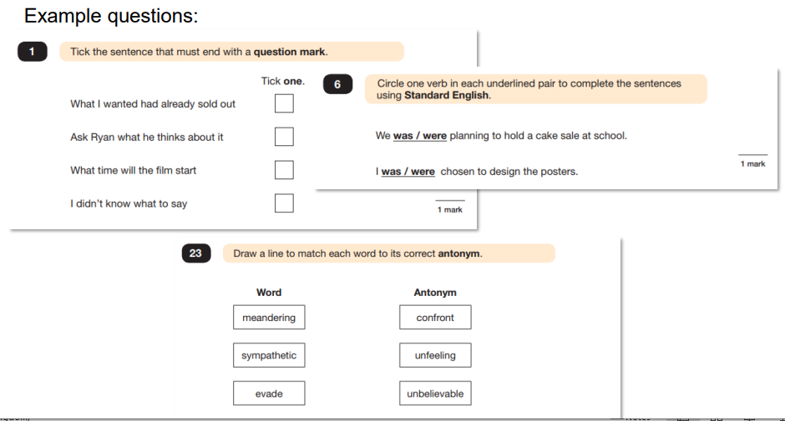
What do the tests look like?
GPaS Paper 1

Slide 8
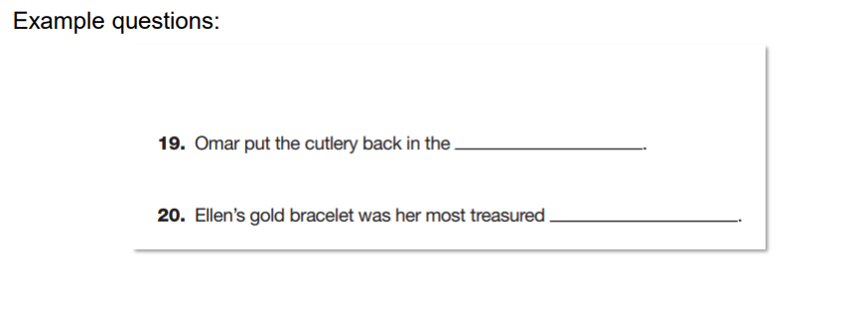
GPaS paper 2 Spelling

Slide 9
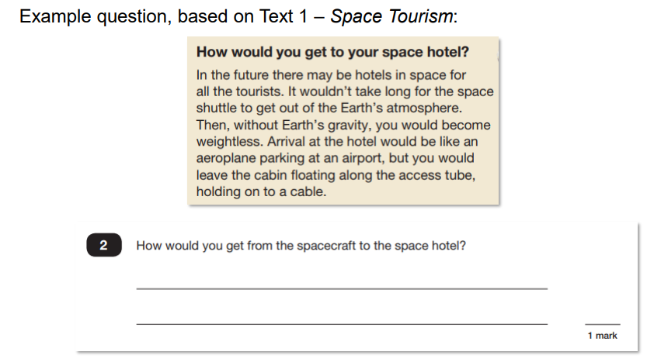
Reading

Slide 10
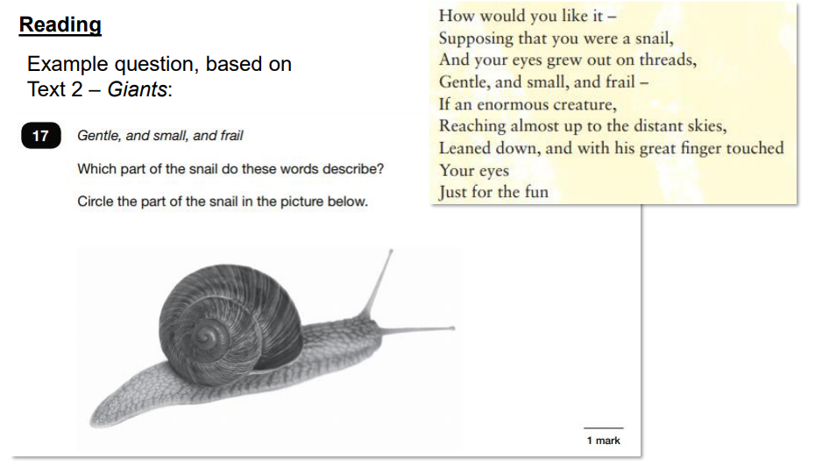
Reading

Slide 11
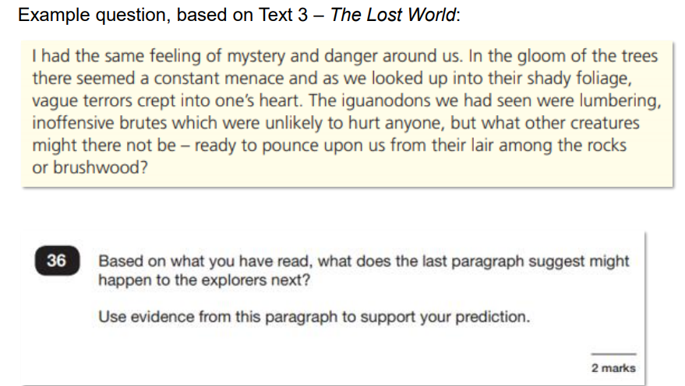
Reading

Slide 12
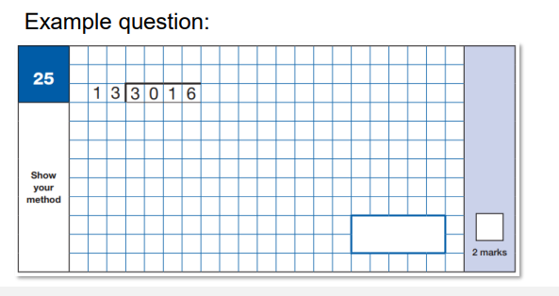
Maths Paper 1 Arithmetic

Slide 13
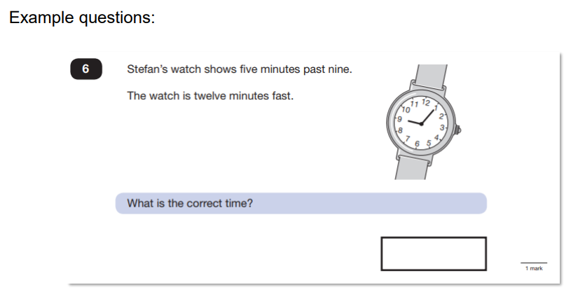
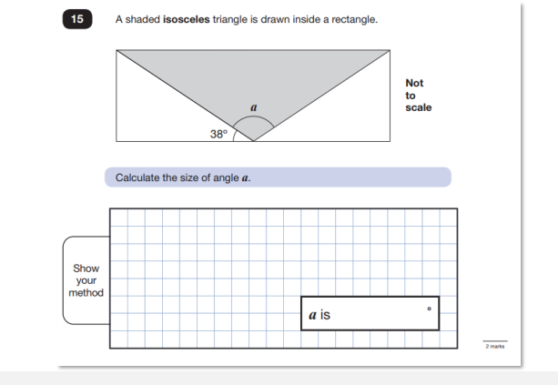
Maths Papers 2 and 3 Reasoning

Slide 14
How is my child’s writing assessed?
There is no writing test.
Writing is assessed using evidence collected throughout Year 6. Your child’s writing in English lessons is used to see if they have met the specific criteria in Writing Teacher Assessment Frameworks designed by DfE.
To make sure each school makes accurate decisions, the DfE ask Local Authorities to check teacher assessment judgements and the evidence used to make them. A sample of schools are moderated each year.

Slide 15
How can I help my child?
Firstly, a positive attitude goes a long way – so as much encouragement and support as possible; (but we don’t need to tell you that)
• Direct any questions or concerns you have about SATs to your child’s teacher, rather than worry your child with them;
• Give your child opportunities to go outside and avoid overuse of screens;
• Try to provide a quiet corner of the house for homework and study, that’s as free from distractions as possible;
• Encourage your child to talk to their teacher if they are worried about SATs. Remember that a small amount of nerves is normal and not harmful;
• Plan something nice and fun for the weekends before and after SATs – this will help your child start the week well and also give them something to look forward to;
• Ensure your child is eating and drinking well, and getting a suitable amount of sleep.

Slide 16
What should I do if I am worried about my child?
It would be unnatural for SATs not to induce a certain degree of worry or anxiety but there is, of course, a tipping point.
SATs should not:
• affect a child’s appetite;
• affect a child’s ability to sleep;
• alter a child’s personality;
• induce panic, tears or disengagement from lessons;
• be a reason not to attend school.
If any of the above are evident, then SATs may be causing an excessive degree of anxiety, and your child may benefit from additional support. Please talk to us.
This isn’t about removing the reality of SATs, but rather equipping your 10 or 11 year old child to cope with the situation and be stronger for it.

Slide 17
What should I do if I am worried?
Talk to us at school
Is your child showing the same symptoms at school as they are at home?
Is there anything else going on at home which may be contributing to your child’s overall level of stress?
Work with us so everyone concerned can be offering the support that’s needed.
Spend time with your child
Try to understand what aspect of SATs concerns them most. Is it the worry of ‘failing’?
Is it the worry of getting stuck on a paper?
If your child can pinpoint what’s bothering them most, you can take steps to help reassure them.
Try not to project your own anxieties or views on the SATs
If you don’t believe in SATs, or do not think your child should be doing them, then neither will they.

Slide 18
Remember!
SATs results don’t always tell the whole story. The results will say they DID or DIDN’T meet a certain standard, but not necessarily by what margin.
The thresholds tend to change each year according to overall national performance, so what was classed as ‘did meet the expected standard’ in 2018 may have been considered a ‘did not’ in 2019, so don’t let your child see SATs as a simple case of ‘pass’ or ‘fail’.
There has also been a global pandemic that has disrupted learning for over 2 years!
SATs focus on what children know about Maths and English. They won’t reflect how talented they are at Science, Geography, Art or PE, and they certainly won’t highlight positive personal characteristics such as kindness and integrity.
SATs last for one week.
In reality it’s just one or two papers lasting 30-60 minutes each day. You can’t emphasise enough the importance of keeping that in perspective.

