Slide 1
Unit 7 a-e ay eigh ai WB 1.3.21

Slide 2
Read write Inc Books can also be accessed online…
Log in to oxford owl using usual log in and password .
The choose the
Read Write Inc ebook library option

Slide 3
A reminder of a-e
ai
ay
eigh
ai ae ay ei eigh a - Phonics Alternative Spellings - YouTube
Long Vowel Letter ai/a-e/ay - English4abc - Phonics song - YouTube

Slide 4
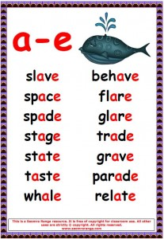
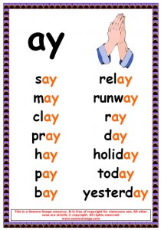
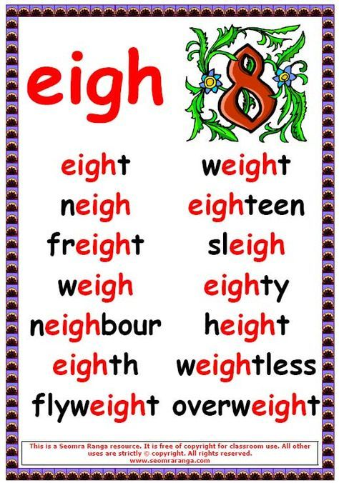
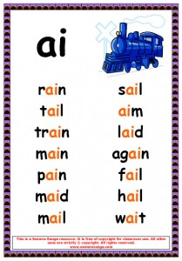
Words to read …

Slide 5
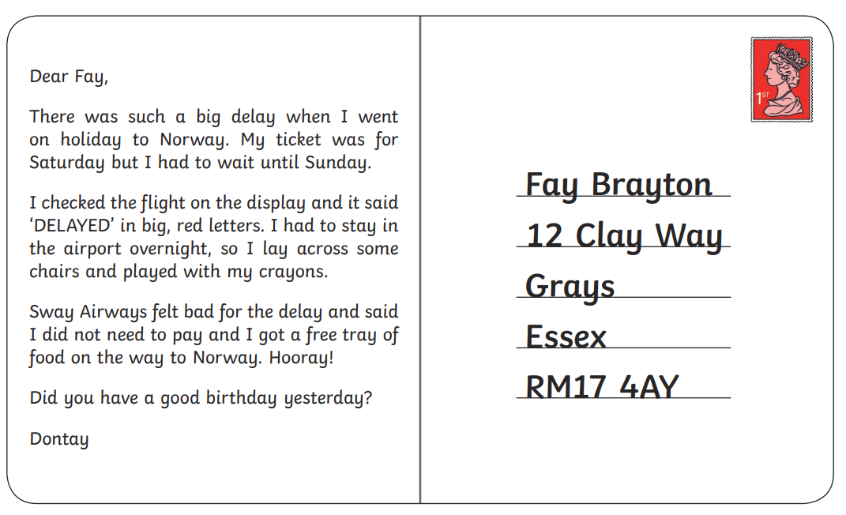
Activity 1a

Slide 6
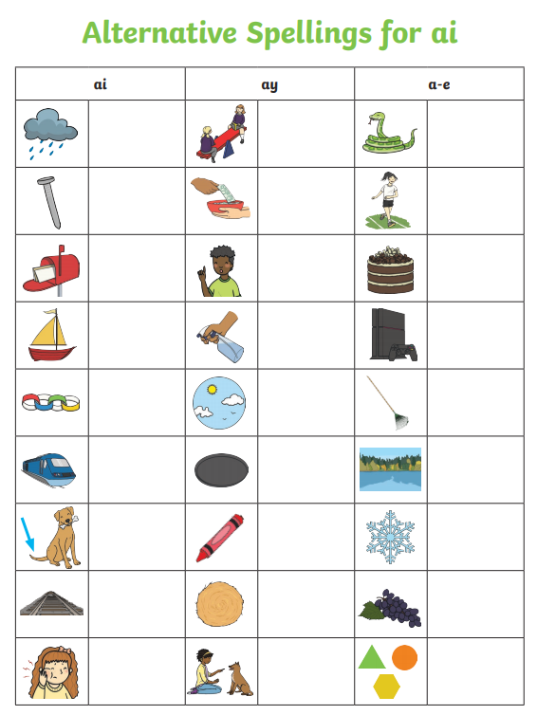
Activity 1b

Slide 7
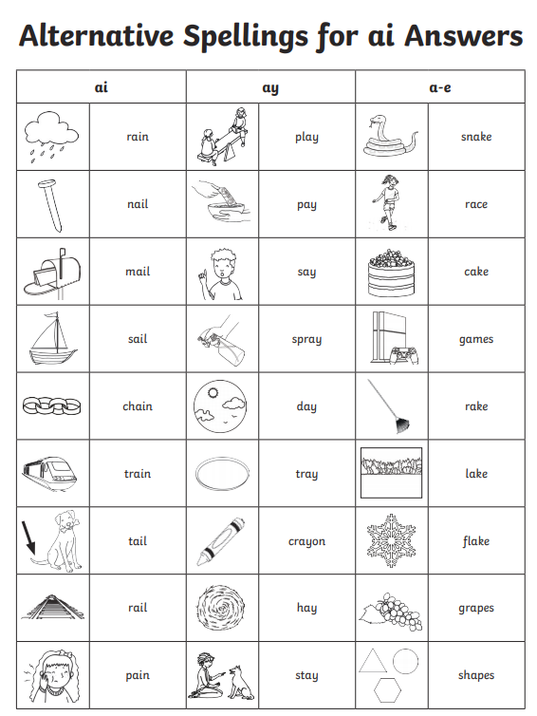

Slide 8
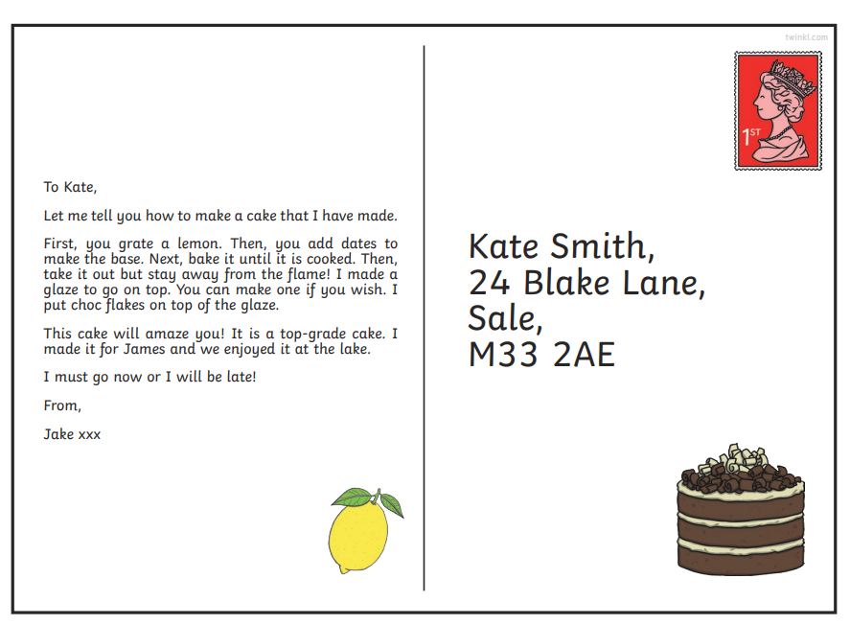
Activity 2

Slide 9
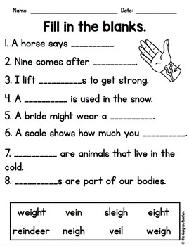
Activity 2b

Slide 10
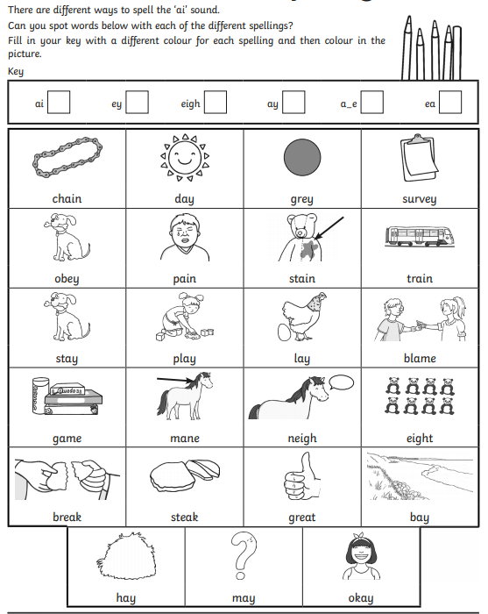
Activity 3
Alternative ai phonemes

Slide 11
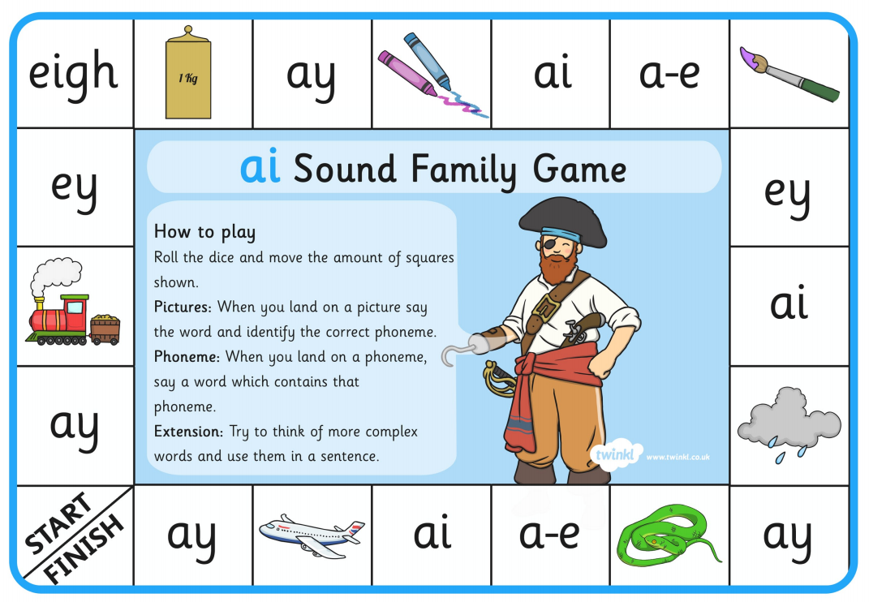
Activity 4

Slide 12
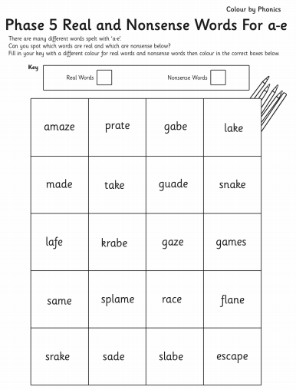
Activity 5
Now put each of the real words you find into a sentence.

