Slide 1
Parent Meeting
Introduction to Read Write Inc.

Slide 2
Reading changes everything
Teach a child to read and keep that child reading and we will change everything.
And I mean everything.
Jeanette Winterson

Slide 3
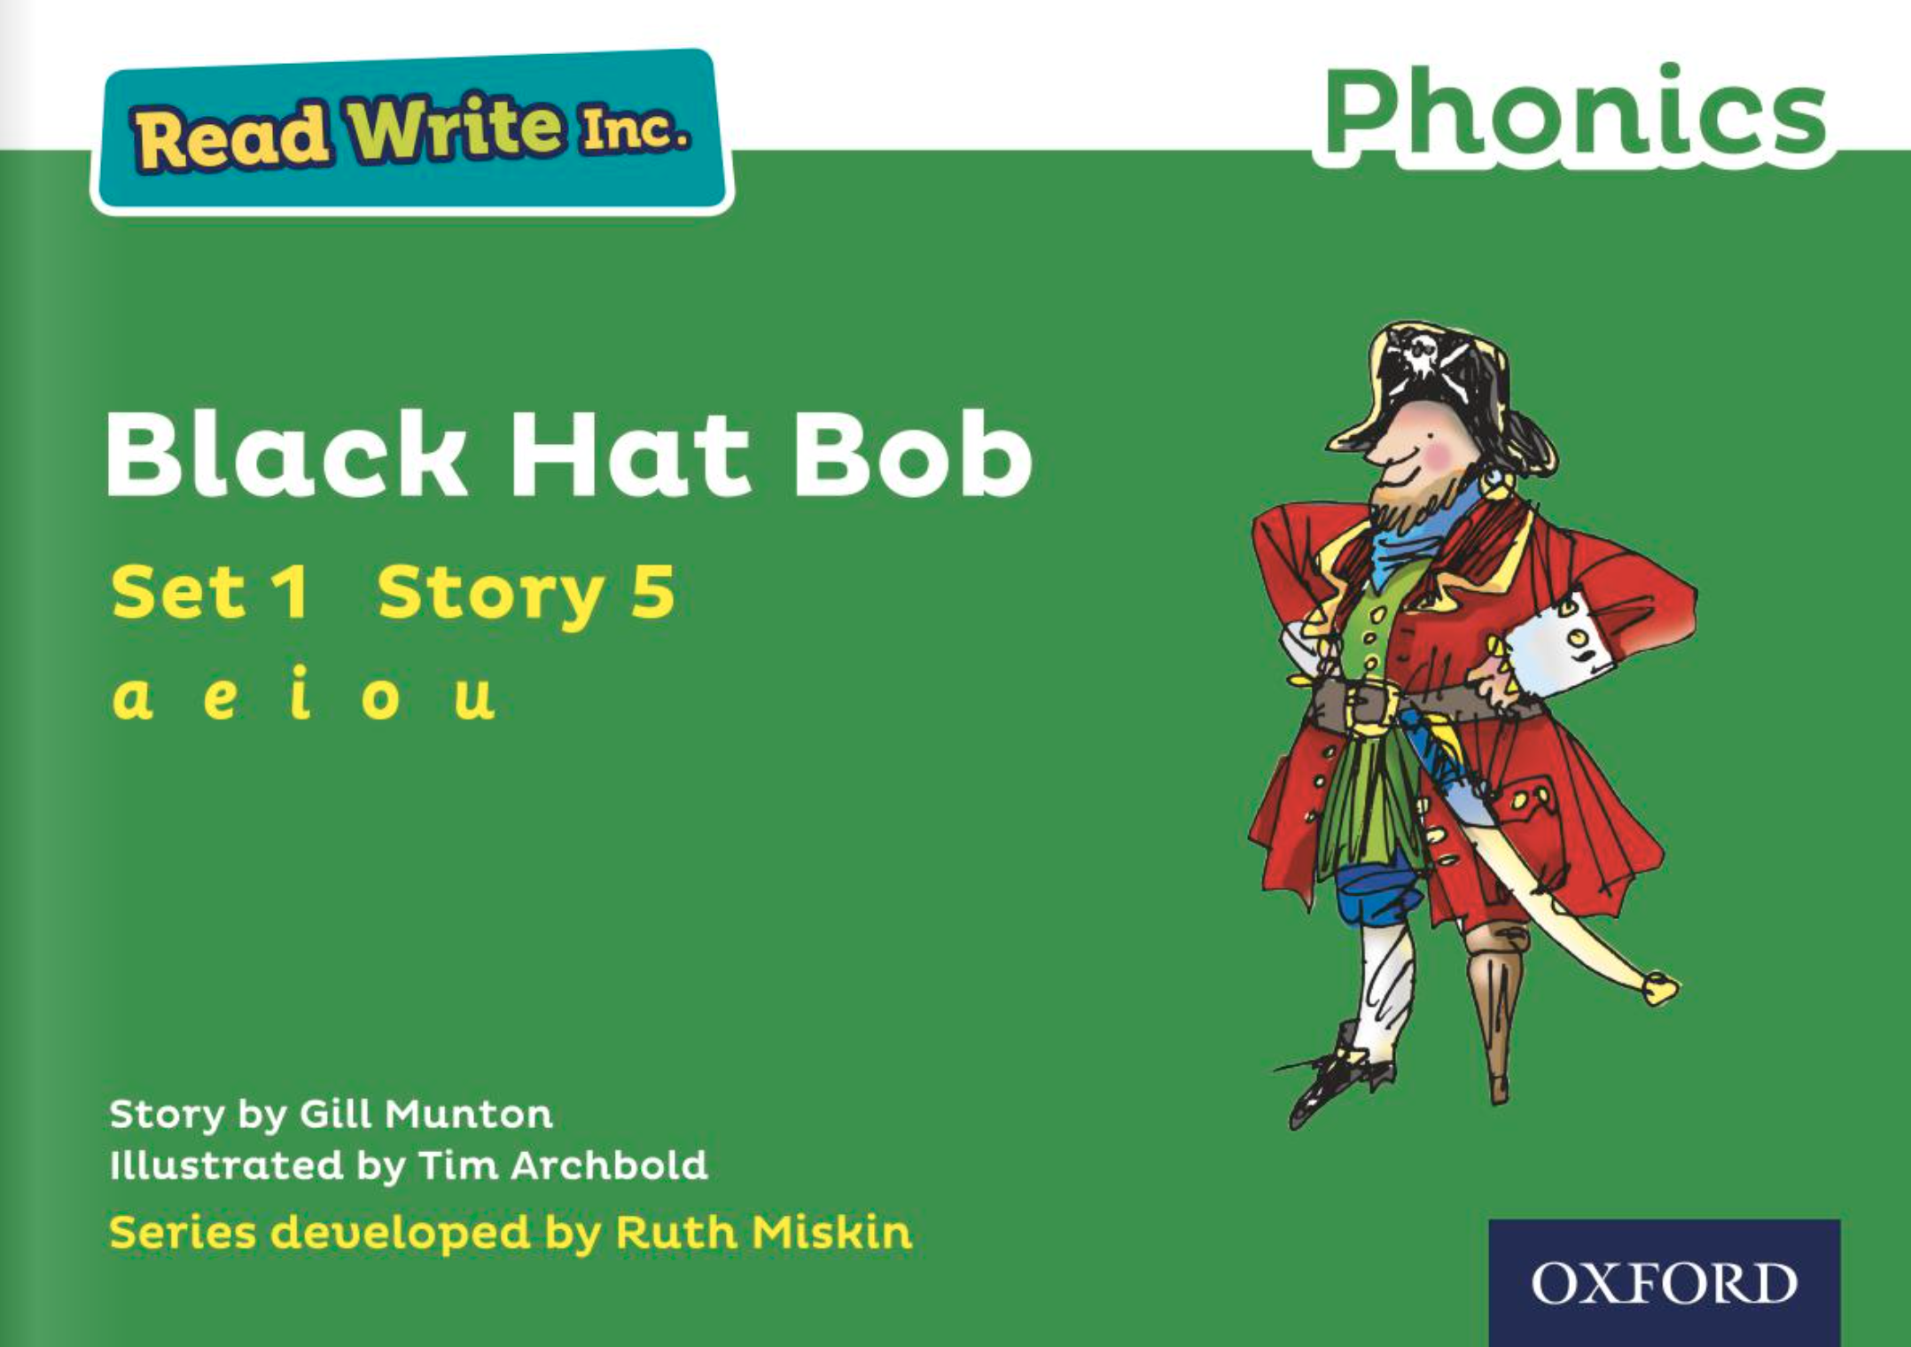
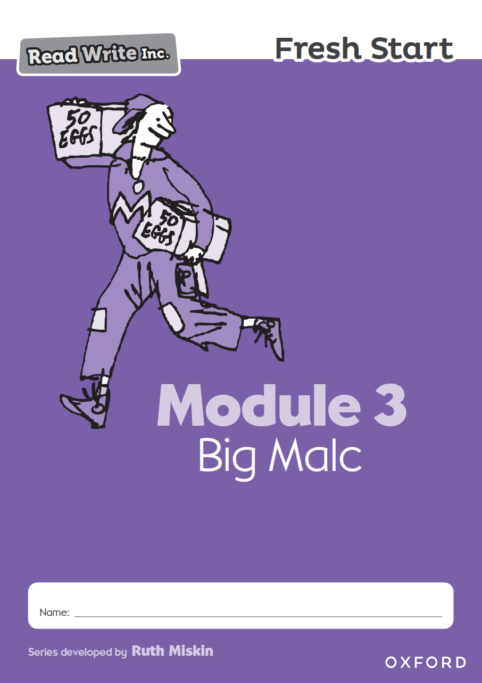
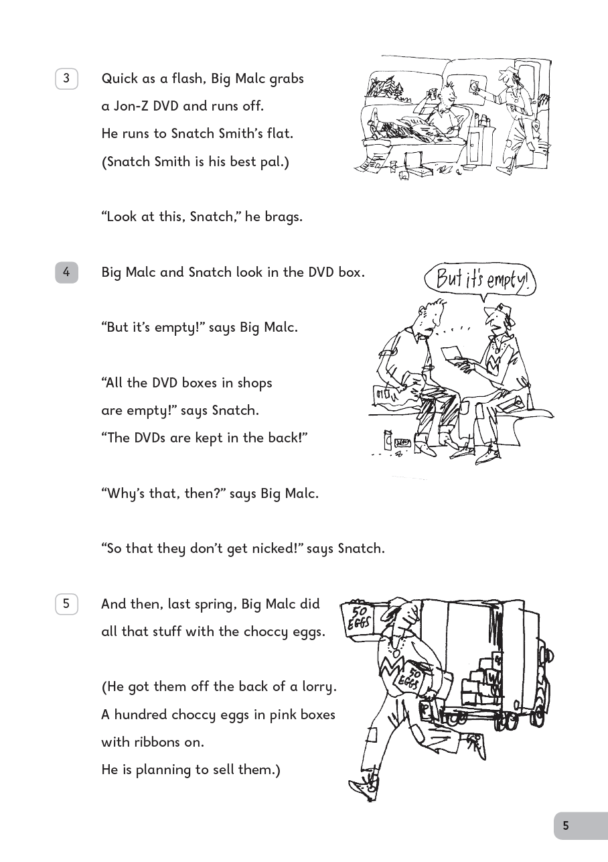
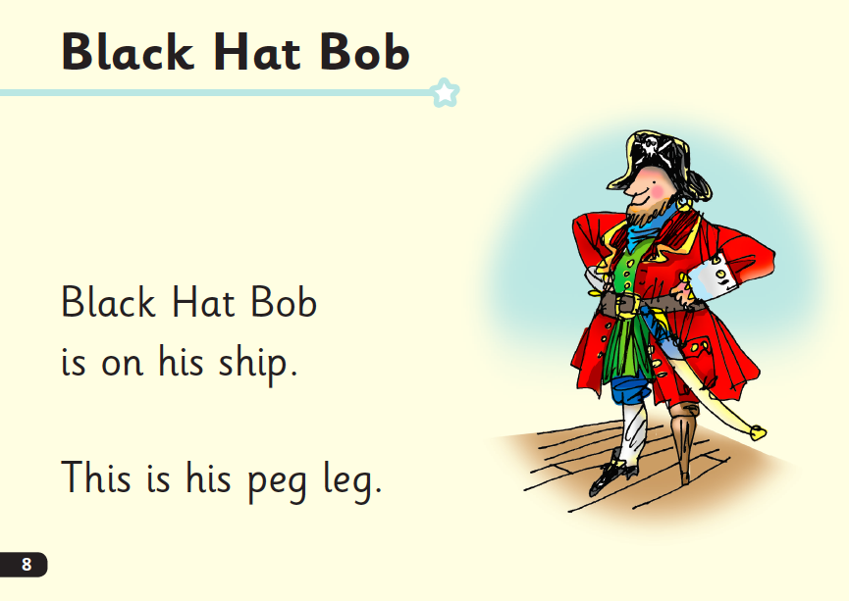
Who is Read Write Inc. for?
Phonics is for children in Reception, Y1 and Y2 who are learning to read.
Phonics is also for children in Y3 and Y4 who haven’t met the KS1 reading expectations.
.
Notes:
Phonics is for children in Reception, Y1 and Y2 who are learning to read.
Phonics is also for children in Y3 and Y4 who haven’t met the KS1 reading expectations.
Fresh Start is for children in Years 5 and 6, who are need extra practice to learn to read.
We want to to make sure they catch up quickly and leave our school a reader.
Fresh Start is structured in the same way as the Phonics programme, but uses age-appropriate texts.

Slide 4

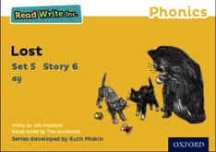


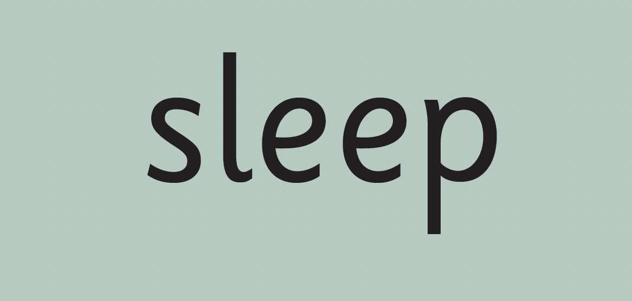

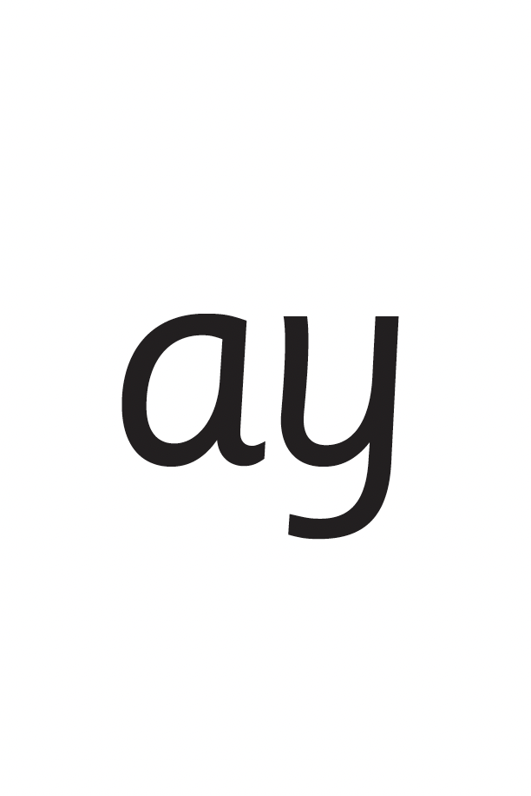

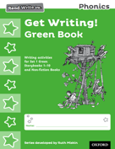
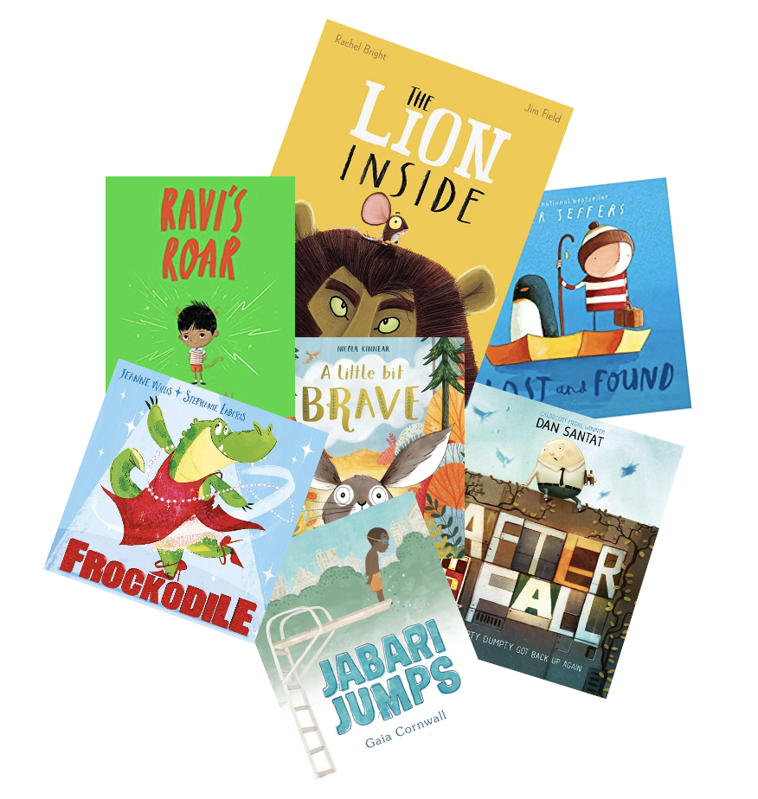
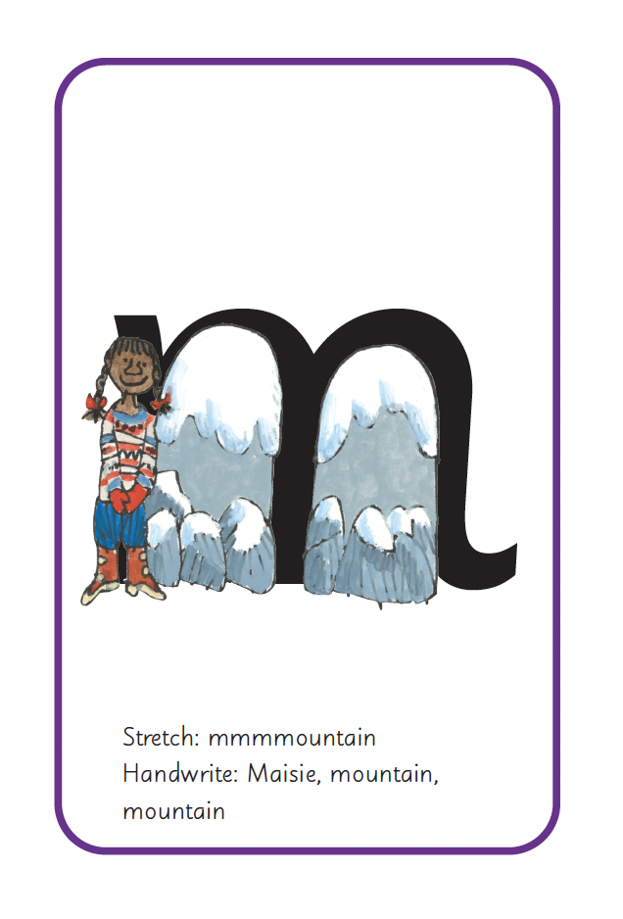
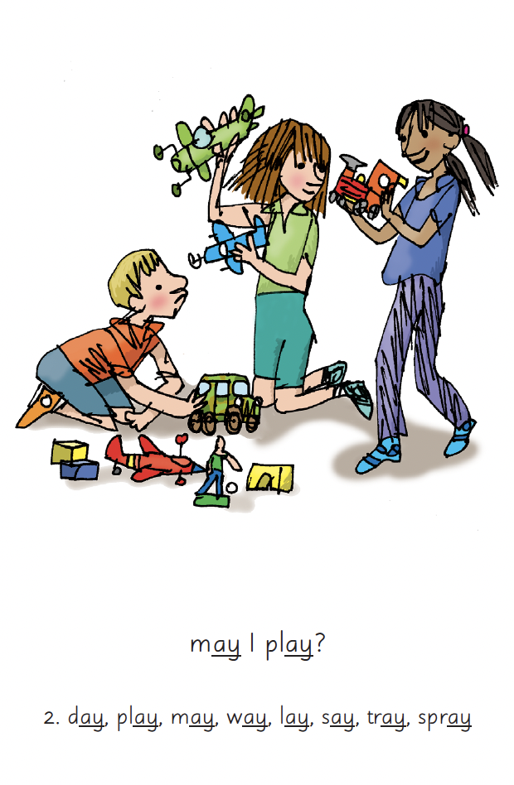
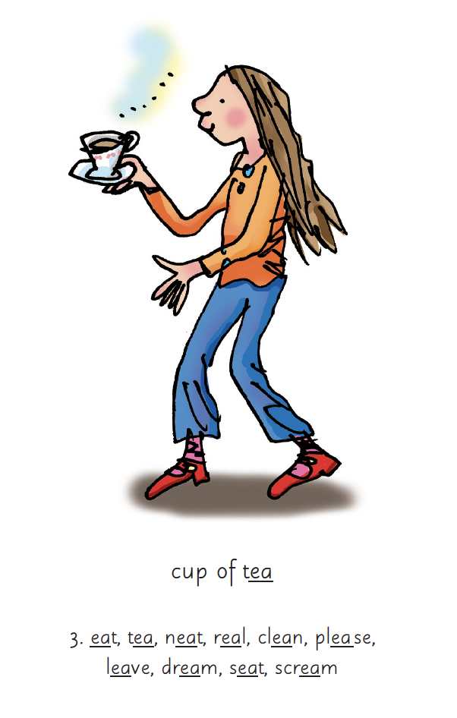
Read Write Inc. Phonics daily lessons
What Read Write Inc. does is simple - we teach children to read and write sounds , children practise reading and spelling words containing these sounds (click), then we give children decodable books (click) containing sounds and words they can read.
Notes:
What Read Write Inc. does is simple - we teach children to read and write sounds , children practise reading and spelling words containing these sounds (click), then we give children decodable books (click) containing sounds and words they can read.
Alongside this we read stories to children: (click) stories they cannot yet read for themselves

Slide 5
Progress groups
Group children by phonic stages.
Teach to the group’s challenge level.
Re-assess all children every half term.
Notes:
In the same way as children learning to swim, play the violin or learn tai kwondo, while your children are learning to read, they work in progress groups to master each level of phonics and reading.
As the reading leader, I assess and re-group the children every half-term.
This allows us to whisk children through the phonic stages as quickly as possible.

Slide 6
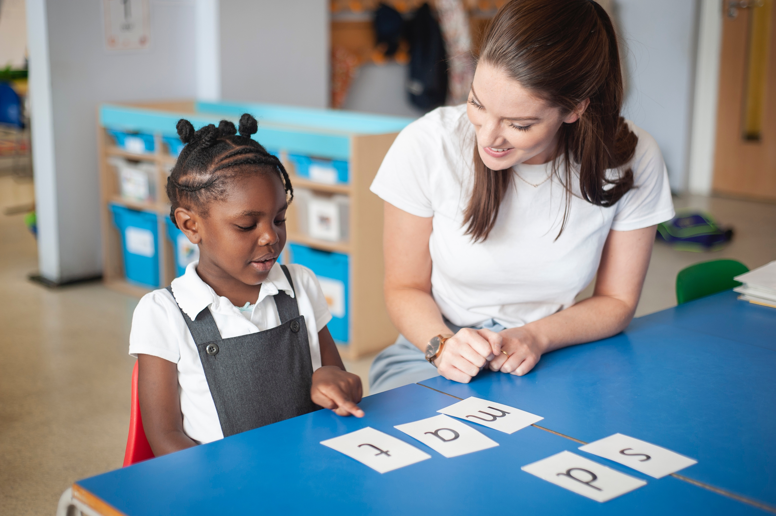
One-to-one tutoring – ‘keep up, not catch up!’
We want to make sure every child learns to read in our school.
Some children need extra practice when learning to read so we teach these children one-to-one for ten minutes every day or in small group intervention – on top of their group lesson.
We make sure they ‘keep up’ from the beginning and don’t need ‘catch up’ later on.
Notes:
We want to make sure every child learns to read in our school.
Some children need extra practice when learning to read so we teach these children one-to-one for ten minutes every day or in small group intervention – on top of their group lesson.
We make sure they ‘keep up’ from the beginning and don’t need ‘catch up’ later on.

Slide 7


What is phonics?
Sounds
Graphemes
All words are made up of individual sounds. These sounds are blended together to form words.
e.g. in ‘mat’ we have the sounds ‘m’, ‘a’, ‘t’, ship – ‘sh’, ‘i’, ‘p’.
Click A grapheme is another name for the letters we use to write the sound. It’s spelling of a sound on the page.
Notes:
All words are made up of individual sounds. These sounds are blended together to form words.
e.g. in ‘mat’ we have the sounds ‘m’, ‘a’, ‘t’, ship – ‘sh’, ‘i’, ‘p’.
Click A grapheme is another name for the letters we use to write the sound. It’s spelling of a sound on the page.
Using phonics, children learn to read by saying each sound and blending them to read a word.
Children learn to spell by segmenting a word into sounds and writing the matching graphemes.
The National Curriculum ensures that all children are taught Phonics systematically.
This gives your children the tools to read any word, for example demonstrate, containing, roamed, trivial, injured, whimper.

Slide 8
English alphabetic code
44 sounds
26 letters
Over 150+ graphemes (letter combinations)
We use 44 sounds to make all the words in the English language.
This means we’ve got a problem.
Click. We’ve got 44 sounds and only 26 letters.
The 26 letters work singly, in pairs and sometimes in threes to represent one sound.
We have to group letters together to write some sounds e.g. ‘igh’, ‘air’.
In English we have more than 150 ways to represent 44 sounds, using the 26 letters in the alphabet.
This makes our language one of the most complex in the world!
Notes:
We use 44 sounds to make all the words in the English language.
This means we’ve got a problem.
Click. We’ve got 44 sounds and only 26 letters.
The 26 letters work singly, in pairs and sometimes in threes to represent one sound.
We have to group letters together to write some sounds e.g. ‘igh’, ‘air’.
In English we have more than 150 ways to represent 44 sounds, using the 26 letters in the alphabet.
Click. This makes our language one of the most complex in the world!

Slide 9
Speed Sounds Set 1 and Set 2
Notes:
Read Write Inc, Phonics makes learning to read easy for children because we start by teaching them just one way of reading and writing every sound. Here they are on the Simple Speed Sounds chart.
We teach Set 1 sounds first - (sounds as far as a e i o u). Then Set 2 – one way to read and write each of the long vowel sounds.

Slide 10
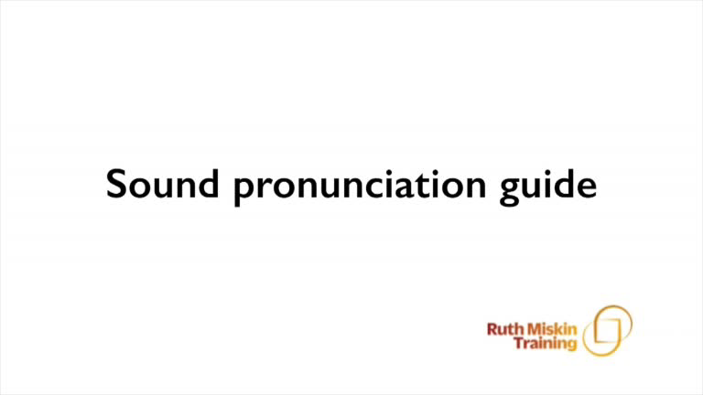
Pure Sounds (ruthmiskin.com)
Children need to know sounds – not letter names – to read words.
We say the sounds in a way to make them easy to blend into a word.
We aim to eliminate the ‘uh’ at the end of the sound. This is called a ‘schwa’ sound.
We say ‘c’ ‘a’ ‘t’ rather than cuh a tuh.
Use MTYT to teach each of the Set 1 sounds to parents.
Notes:
Children need to know sounds – not letter names – to read words.
We say the sounds in a way to make them easy to blend into a word.
We aim to eliminate the ‘uh’ at the end of the sound. This is called a ‘schwa’ sound.
We say ‘c’ ‘a’ ‘t’ rather than cuh a tuh.
Use MTYT to teach each of the Set 1 sounds to parents.

Slide 11
Speed Sounds Set 3
Once children know how to read Set 2 sounds, they start to learn Set 3 sounds.
These are different ways to read and spell Set 2 sounds.
Notes:
Once children know how to read Set 2 sounds, they start to learn Set 3 sounds.
These are different ways to read and spell Set 2 sounds.
We call these Set 3 sounds, but actually they are the same sounds as in Set 2 but with a different spelling.
We say "same sound, different spelling".
Point to the chart to show. For example, they know ‘ay’ and now learn a-e and ai as other spellings for the same sound.
Once they know all of these sounds, they will be able to read any unfamiliar word.

Slide 12
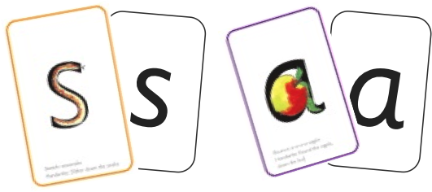
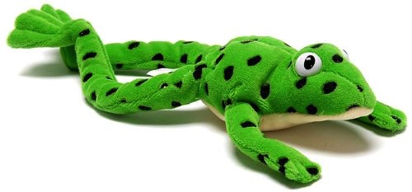

Sounds + blending = word reading
+
=
Alongside teaching children sounds, we teach them to blend sounds to read words e.g. s-a-t, sat.
Once children can read sounds speedily, like this, (show how speedily this needs to be) and understand Fred (m-a-t...mat) , they can decode words.
Notes:
Alongside teaching children sounds, we teach them to blend sounds to read words e.g. s-a-t, sat.
Once children can read sounds speedily, like this, (show how speedily this needs to be) and understand Fred (m-a-t...mat) (click), they can decode words.

Slide 13
Meet Fred
Let me introduce you to Fred.
Fred helps children learn to blend sounds into a word.
Fred can only speak in sounds. He says d-o-g, h-a-t etc.
He says the sounds c-a-t, and then children help him to say the word.
This is how we quickly teach all of our children to blend orally.
We practise blending orally so children will find word-reading easier.
Notes:
Let me introduce you to Fred.
Fred helps children learn to blend sounds into a word.
Fred can only speak in sounds. He says d-o-g, h-a-t etc.
He says the sounds c-a-t, and then children help him to say the word.
This is how we quickly teach all of our children to blend orally.
We practise blending orally so children will find word-reading easier.

Slide 14

Teach spelling using Fred Fingers
We use Fred Fingers to help children sound out words to spell easily.
It means they do not have to memorise lists of spelling words.
It is a tool so they will be able to spell any word.
Notes:
We use Fred Fingers to help children sound out words to spell easily.
It means they do not have to memorise lists of spelling words.
It is a tool so they will be able to spell any word.

Slide 15
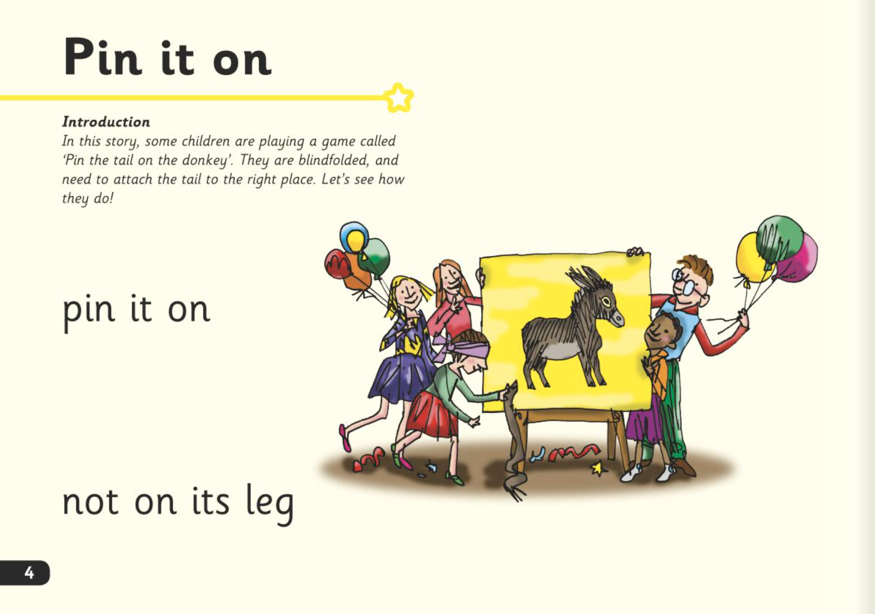
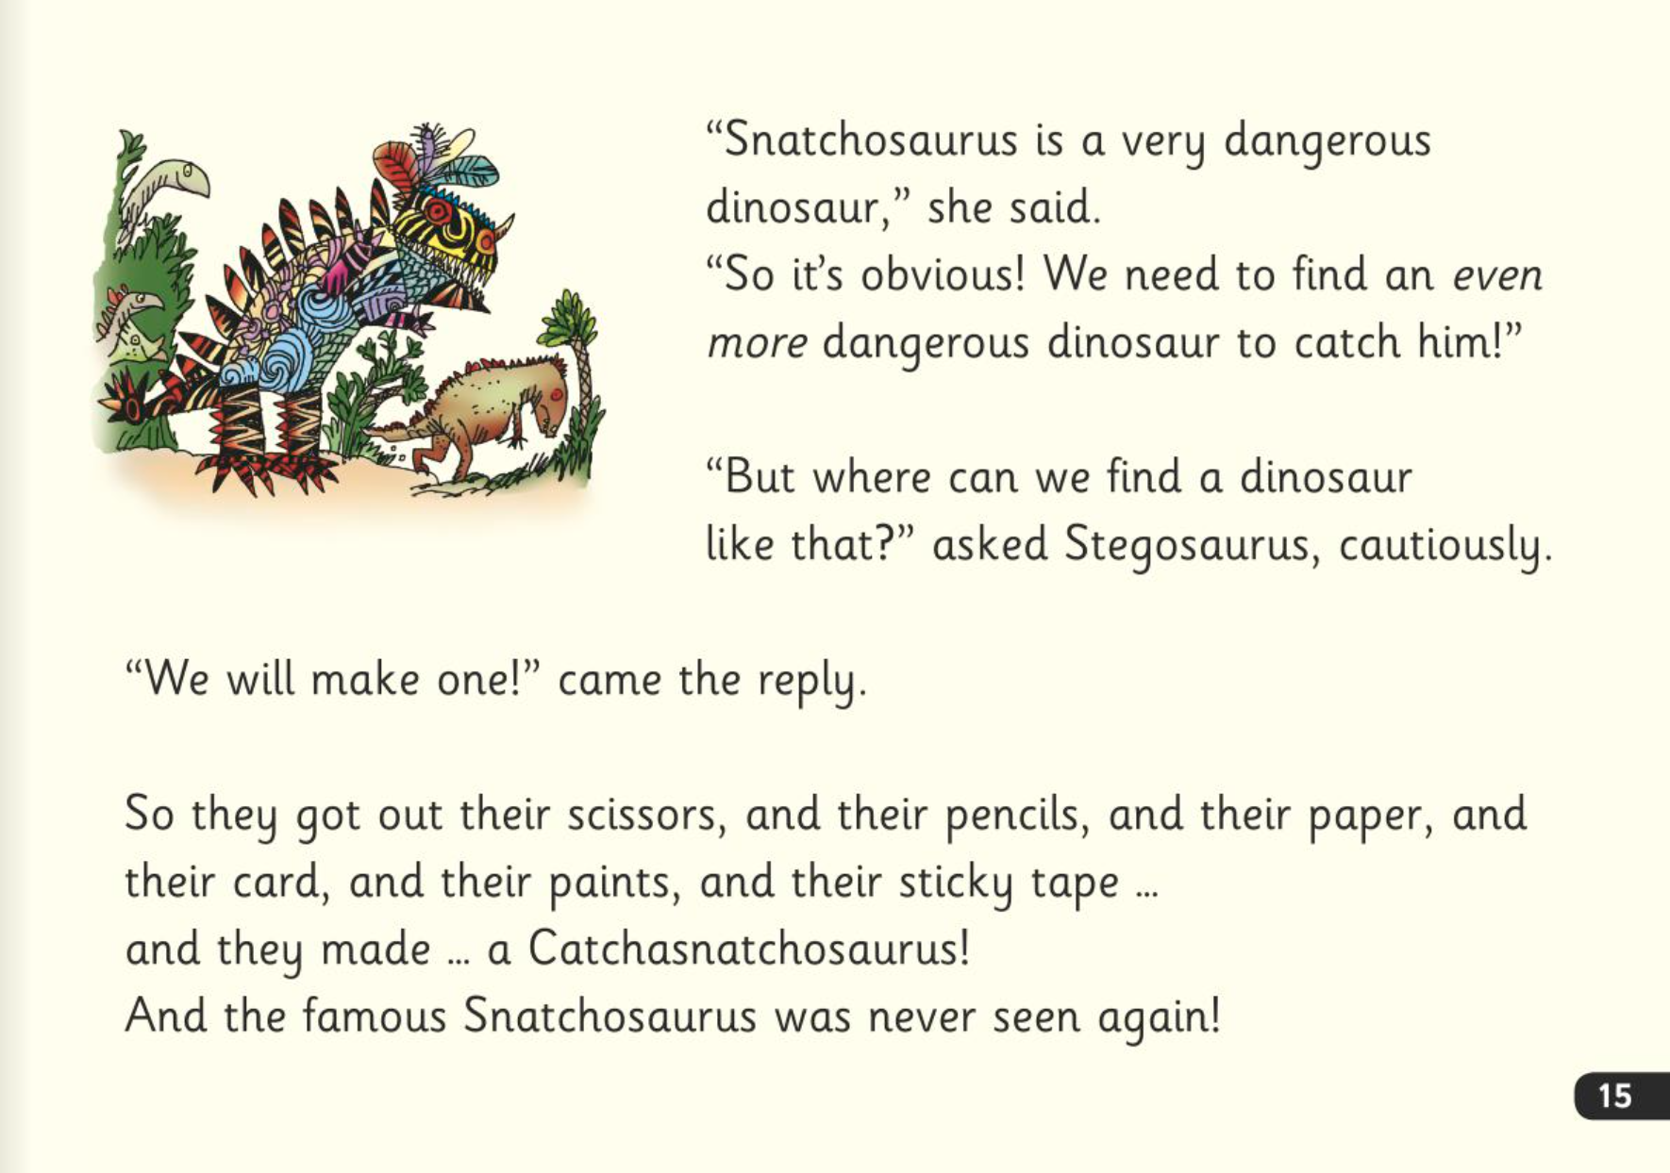
Three reads
In our school, children read Read Write Inc. Storybooks that match the sounds they can read.
They read each Read Write Inc. Storybook three times in class with their partner.
Re-reading the same book helps children to become confident readers. Each time they re-read, they build their fluency/speed and comprehension.
They love reading and want to read because they can read all of the words in the Storybook.
Notes:
In our school, children read Read Write Inc. Storybooks that match the sounds they can read.
They read each Read Write Inc. Storybook three times in class with their partner.
Re-reading the same book helps children to become confident readers. Each time they re-read, they build their fluency/speed and comprehension.
They love reading and want to read because they can read all of the words in the Storybook.

Slide 16

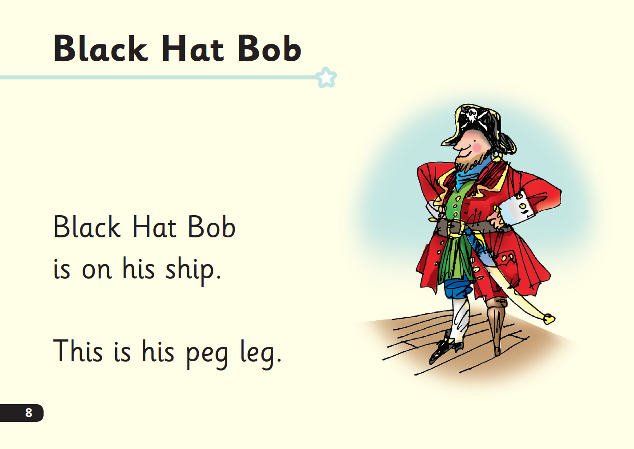
‘Special Friends’, ‘Fred Talk’
Children will be able to read all of the words in the Storybook.
If they hesitate, remind them to read the word using ‘Special Friends, Fred Talk,’.
For example, this means they spot the ‘sh’, then Fred Talk and blend to read the word e.g. sh, sh-i-p, ship.
Notes:
Children will be able to read all of the words in the Storybook.
If they hesitate, remind them to read the word using ‘Special Friends, Fred Talk,’.
For example, this means they spot the ‘sh’, then Fred Talk and blend to read the word e.g. sh, sh-i-p, ship.

Slide 17

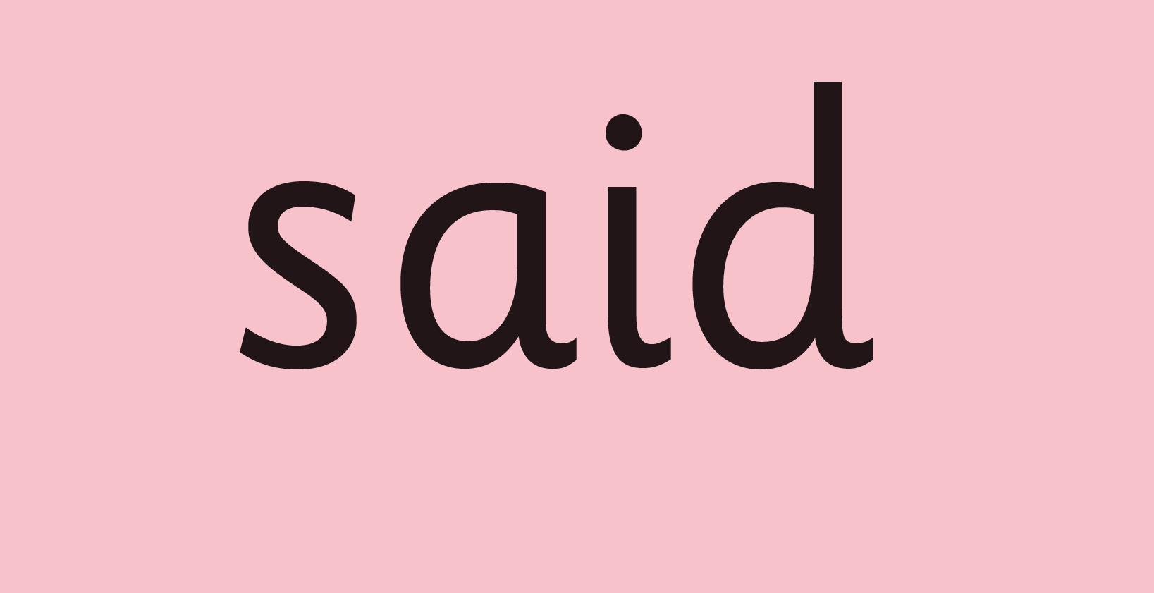
Red Words
Some words are ‘tricky’ because they contain letters that don’t match the sounds the child has been taught.
For example, ‘said’ has ‘ai’ making an ‘e’ sound.
We teach these common exception words as Red words.
In the early Storybooks, these words are printed in red text.
Remind your child not to use Fred Talk to read Red words but instead to stop and think if they know the word. Tell them the word if needed.
Notes:
Some words are ‘tricky’ because they contain letters that don’t match the sounds the child has been taught.
For example, ‘said’ has ‘ai’ making an ‘e’ sound.
We teach these common exception words as Red words.
In the early Storybooks, these words are printed in red text.
Remind your child not to use Fred Talk to read Red words but instead to stop and think if they know the word. Tell them the word if needed.

Slide 18
Which books will children bring home?
+
A book corner book
from class
In your child’s book bag, they will bring home:
- a Book Bag Book that links to the story they have read in class.
A book corner book to share with you as a reading for pleasure text. You can read the story to them or they can retell the story by looking at the pictures. They are not expected to read the story themselves.

Slide 19
What can I do?
Use pure sounds rather than letter names.
Use Fred Talk to help your child to read and spell words.
Listen to your child read their Storybook every day.
Read stories to your child every day.
Notes:
We will run regular bitesize meetings to look at each of these in more detail.

Slide 20
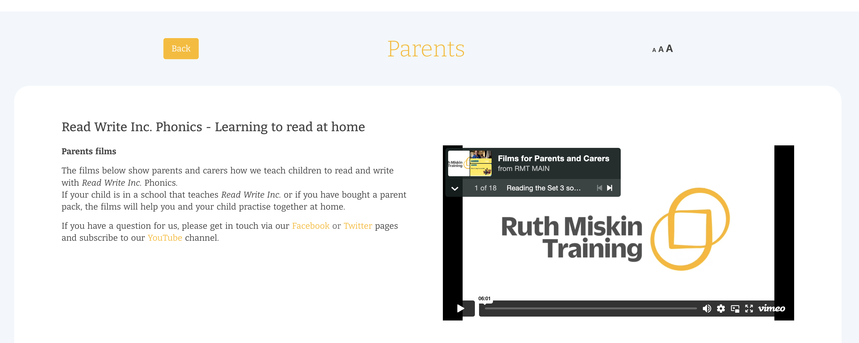
Free Video Tutorials (ruthmiskin.com)
Notes:
Watch video tutorials on the Ruth Miskin website to help you to understand more about Phonics, Read Write Inc. and how to practise reading and writing with your child at home.

Slide 21
Online resources available
Ruth Miskin Parents’ Page:
https://www.ruthmiskin.com/parents/
Ruth Miskin Facebook:
https://www.facebook.com/miskin.education
Free e-books for home reading:
http://www.oxfordowl.co.uk/Reading/

Slide 22
Reading feeds the imagination, it expands
horizons and offers new and exciting ways of
seeing and making sense of our lives and of
the world around us.
Michael Morpurgo
Notes:
Remember…you all have the power to change outcomes for your children.

