Slide 1
Anti-Bullying week
15th-19th November 2021
“One Kind Word”

Slide 2
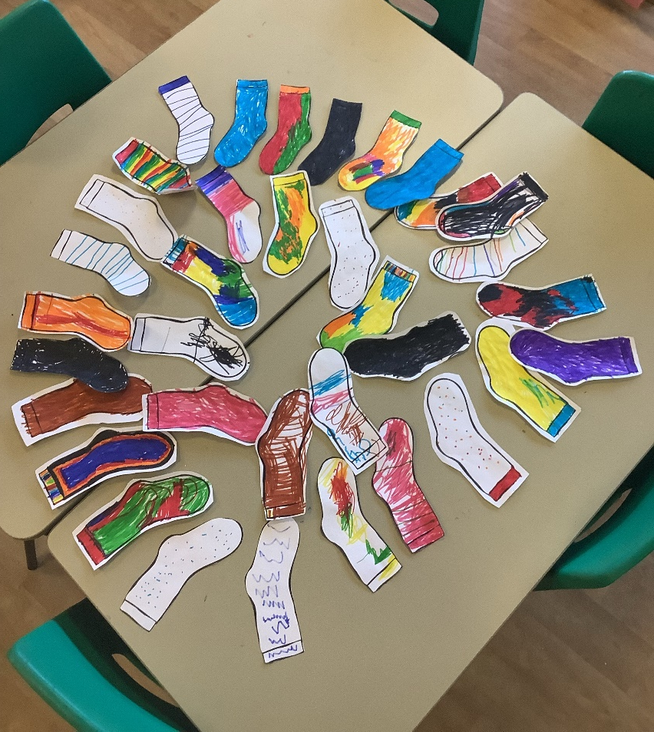
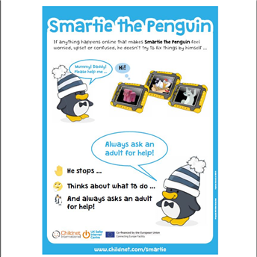

EYFS
Nursery children read ‘Sweep’ by Louse Greig a book about emotions and how to deal with sadness and anger.
They also looked at Smartie the Penguin and found out about what to do when faced with pop ups and in app purchasing.
Reception talked about what Bullying is and read stories about bullying. You watched Andy and the Odd Socks and then designed your own odd socks.

Slide 3
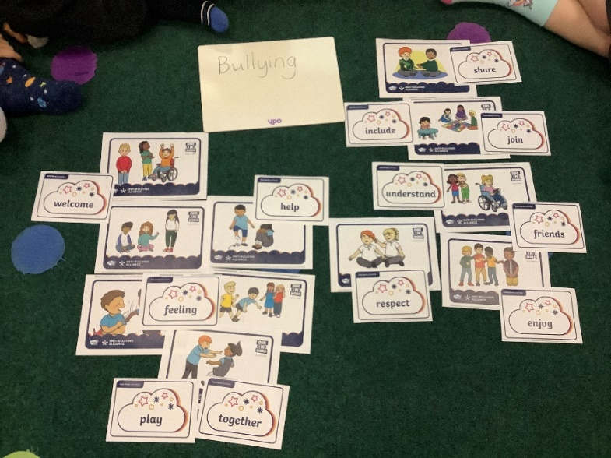
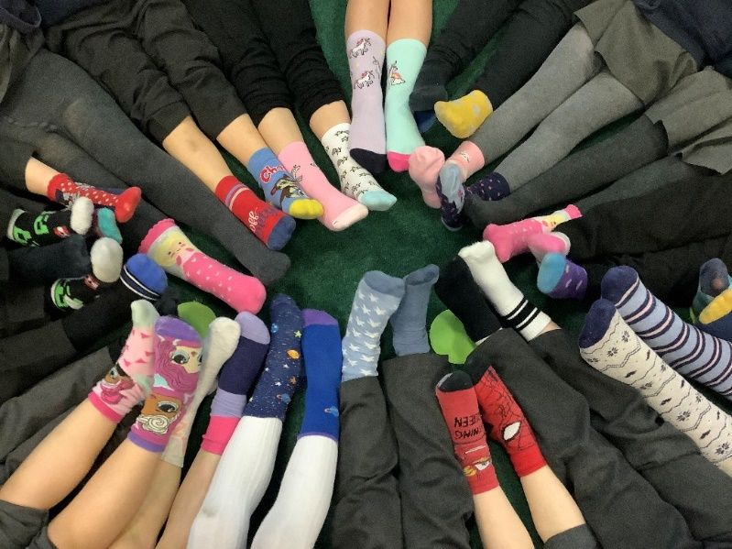
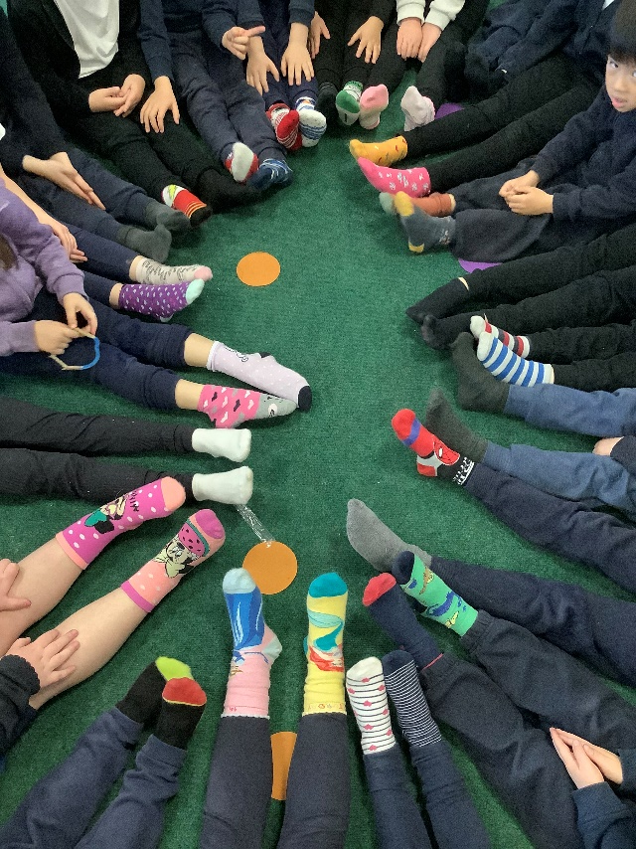

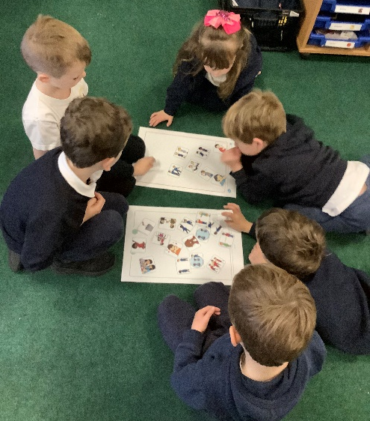
Year 1
We enjoyed wearing our odd socks and celebrating our differences.
Year 1 identified what bullying is and the types of bullying using scenario cards. We talked about how we could help the children in the pictures.
Year 1 read the story ‘Tyrannosaurus Drip’ by Julia Donaldson. We did drama using conscience alley and role play. We talked about all the unkind things the dinosaurs said to Drip. We suggested how we could be kind to Drip through actions and words.

Slide 4
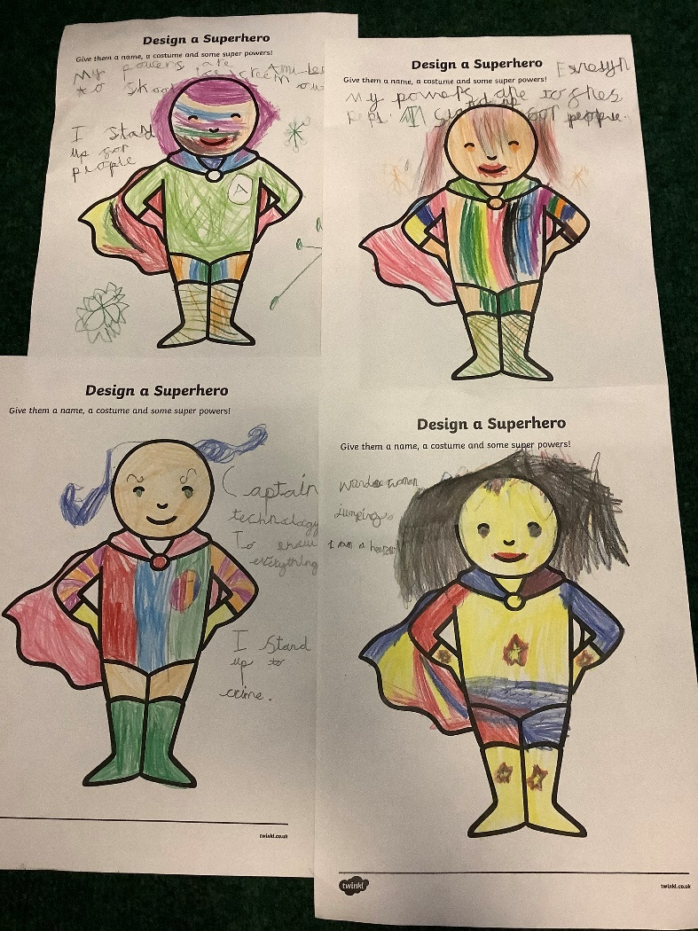

Year 2
Year 2 read the story ‘Newspaper boy and Origami girl’ by Michael Foreman
A story of how to deal with a bully.
Year 2 talked about how to be kind to others. They discussed what qualities their superhero would have.

Slide 5
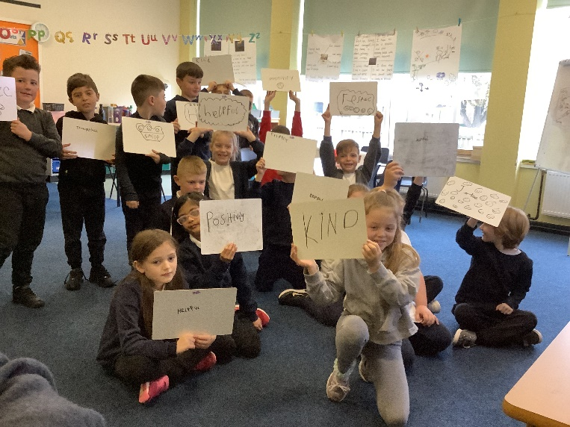
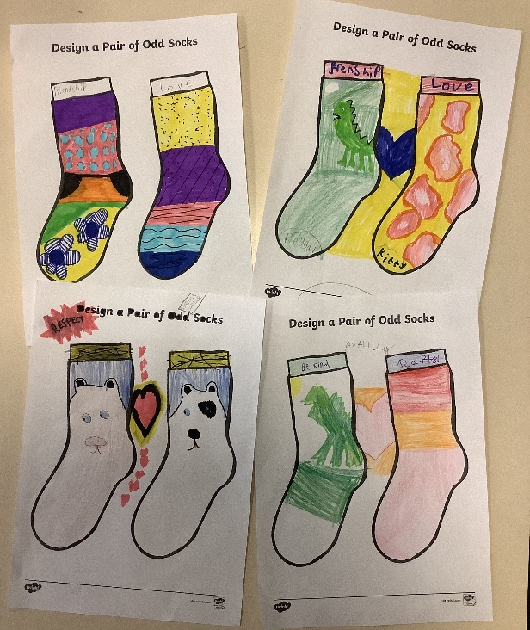
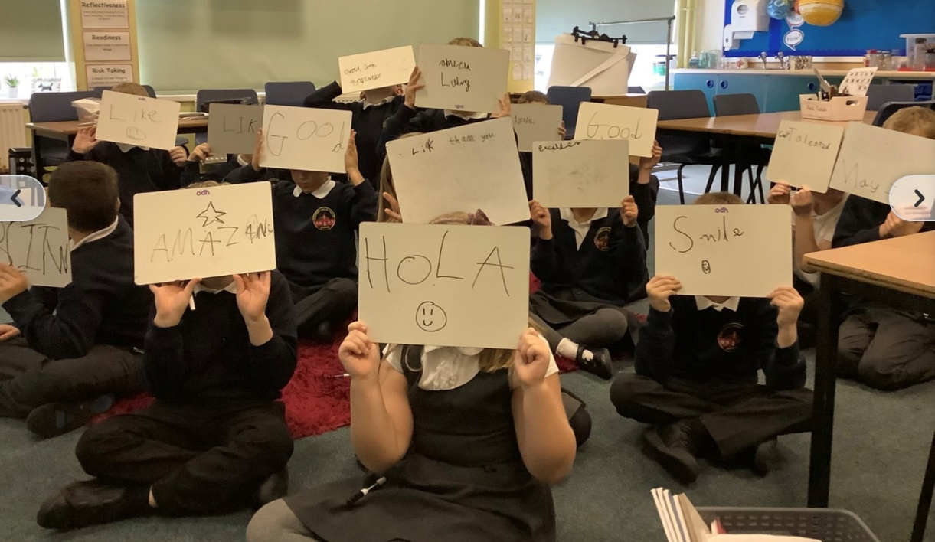
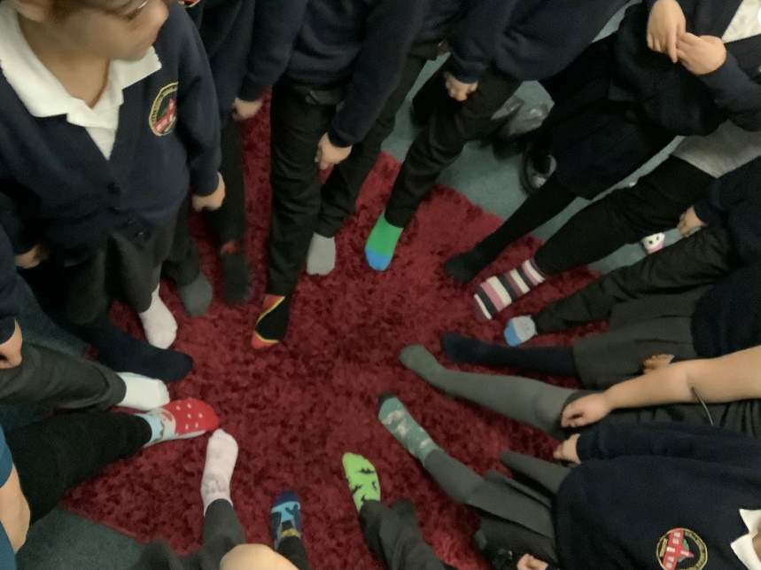
Year 3
Year 3 wore and designed Odd socks. They also talked about ‘One Kind Word’ and came up with their own suggestions to use.

Slide 6
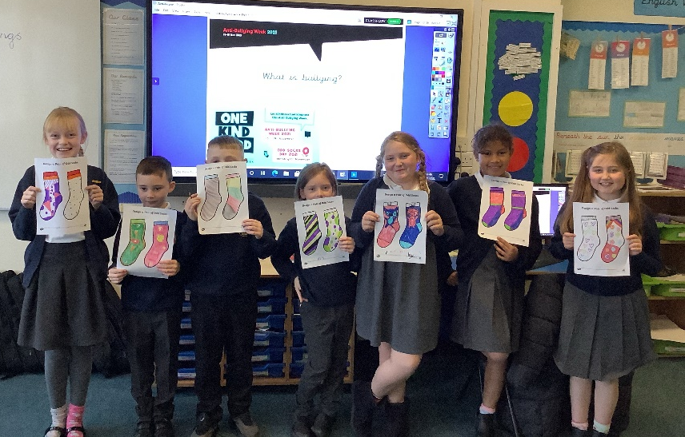
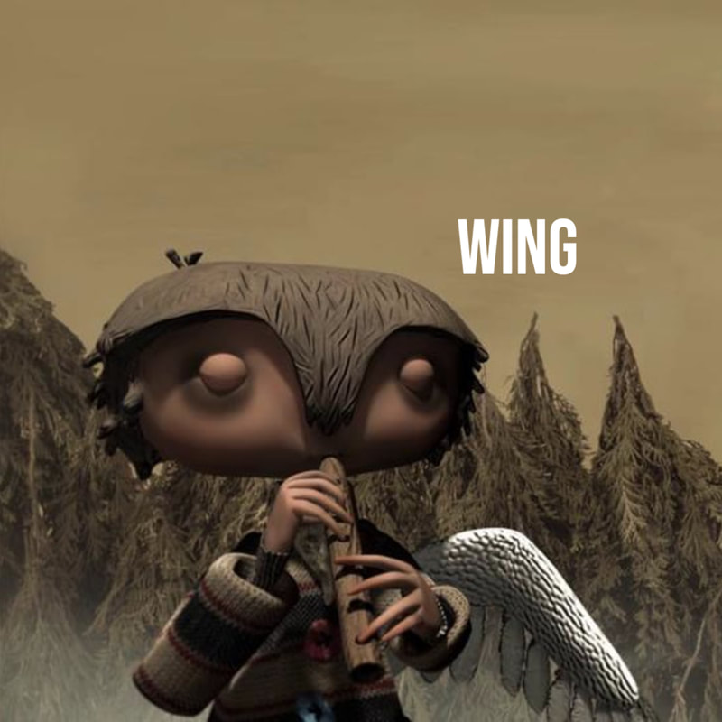
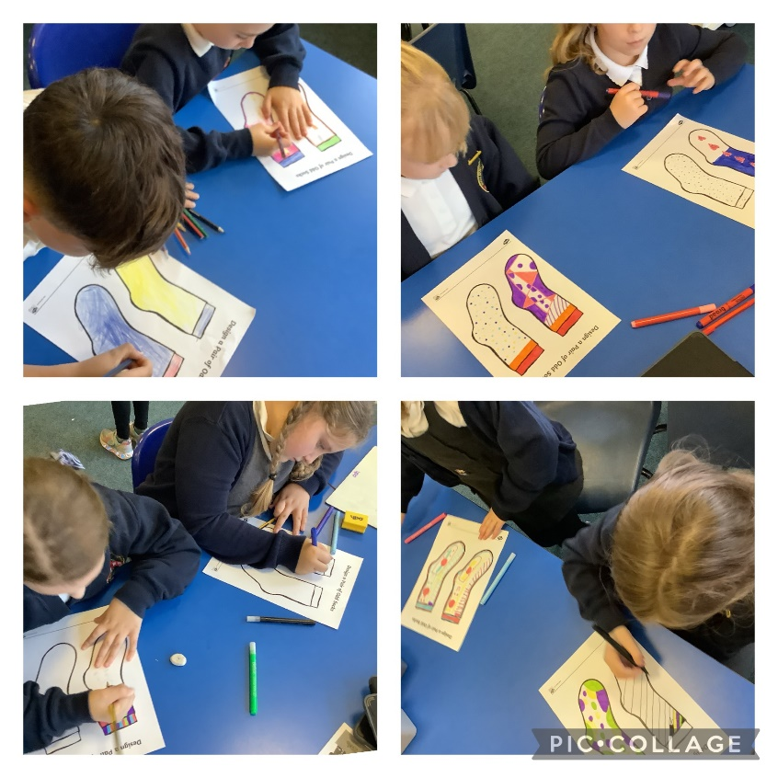
Year 4
As part of online bullying Year 4 watched a video about Nadiya, who was being bullied online. The children all emailed Nadiya some advice. Here is an example;
Hi Nadiya, sorry to hear that people are being mean to you but we may have a solution for your problem. I suggest you should tell your parents and teachers they will understand Don't be worried. First of all block the online chat and join some school clubs. Don't listen to them. You should try making friends at school and at different clubs. Just because you are from a different country you are not worse from every one you are you. Just because people say bad things about you they are not true.
from Heidi and Olivia
They used the story book creator app to create their own anti-bullying story based on the short film Wing.

Slide 7
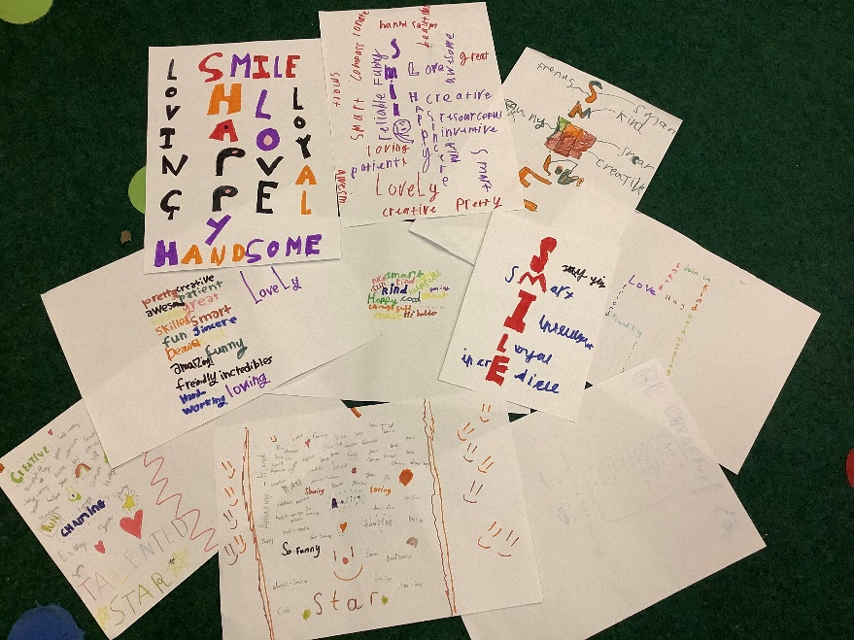
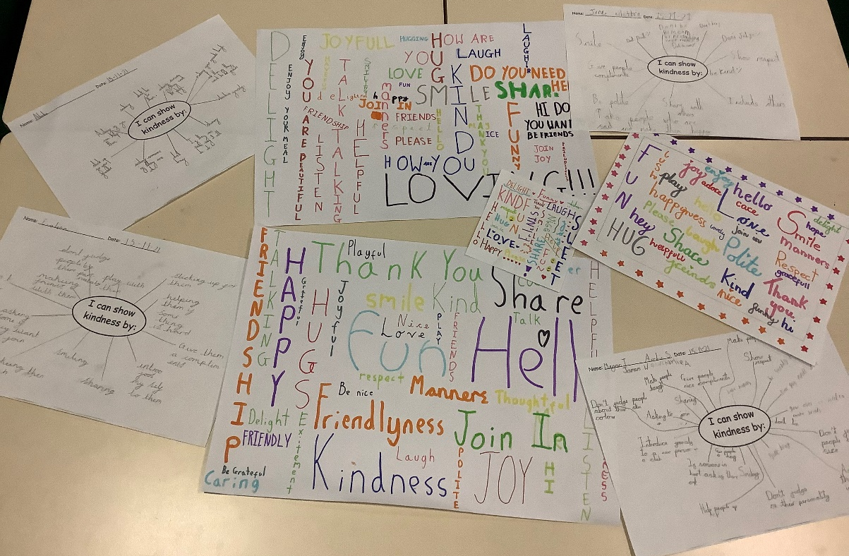
Year 5
Year 5 designed odd socks. They discussed kind words they could use and made posters.
They did thought showers about how to show kindness to others.

Slide 8
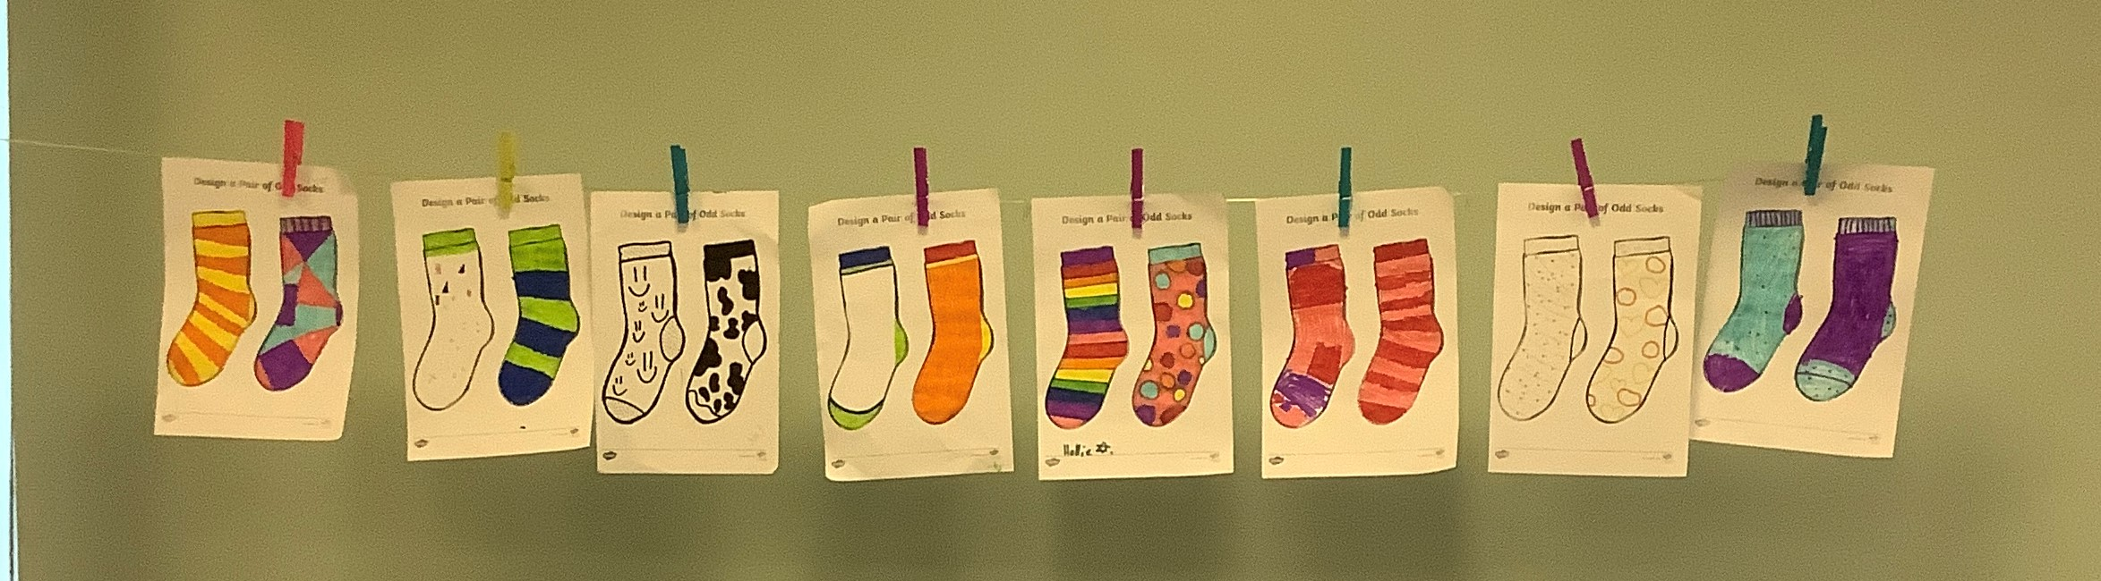
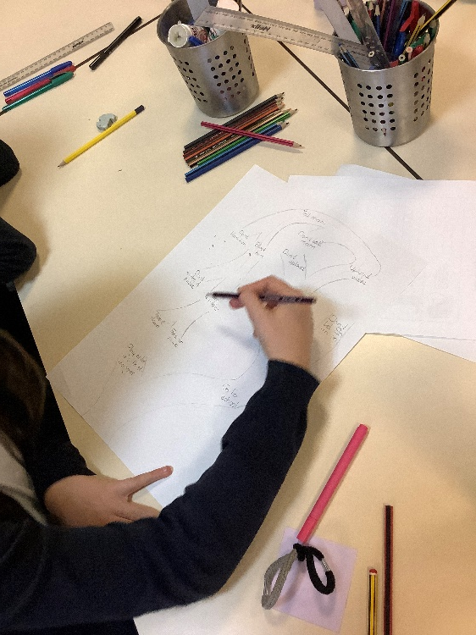
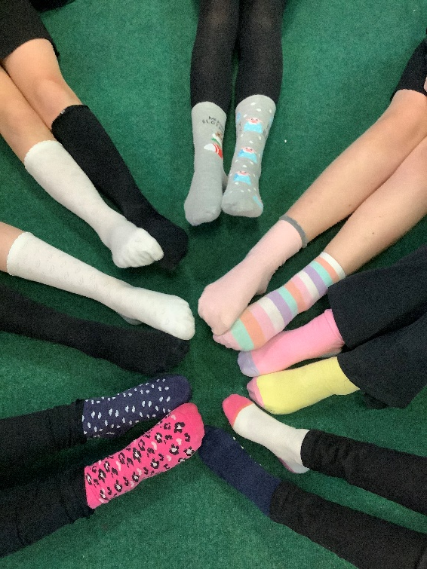
Year 6
Year 6 wore and designed Odd socks. They also talked about ‘One Kind Word’ and discussed how to be kind through actions and words.

